Slide 1
My CI/CD pipeline contains all security tools available! Now what...?
Just adding more tools won‘t make your products more secure
Jasmin Mair
Bsides Munich 2023 – 7 SYNS

Slide 2

Jasmin Mair
Global Product Security Manager @
Leica Microsystems
Connect with me:
jasmin.mair@owasp.org
linkedin.com/in/jasminmair
BSides Munich 2023 - 7 SYNs
Notes:
Jasmin Mair
Italian living in Germany
Hobbies -
See different areas (Cloud, agile, …security)
Past years at IBM and now in a global role – transformation journey
As a consultant I have seen few clients and what how they want to tackle the problems

Slide 3
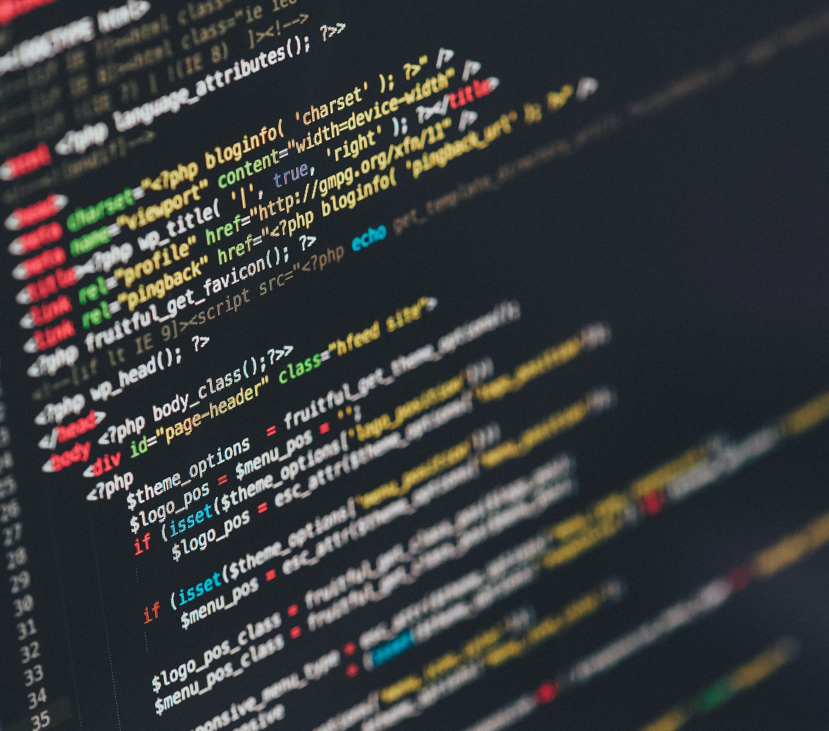
AGENDA
Temptation to buy more tools
What are teams really struggling with?
Let’s figure a way out
Implement tools responsibly
Practical example
Credits: Ilya Pavlov on Unsplash

Slide 4
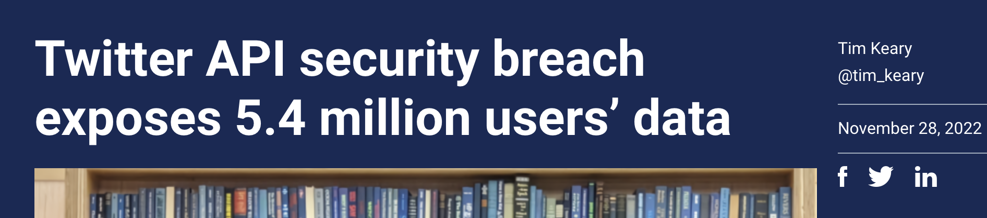
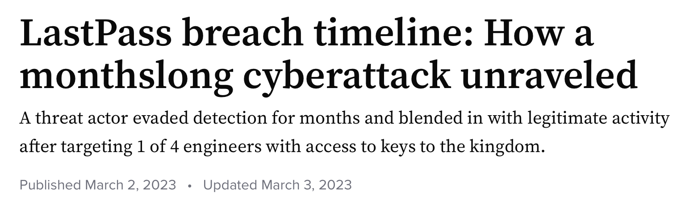
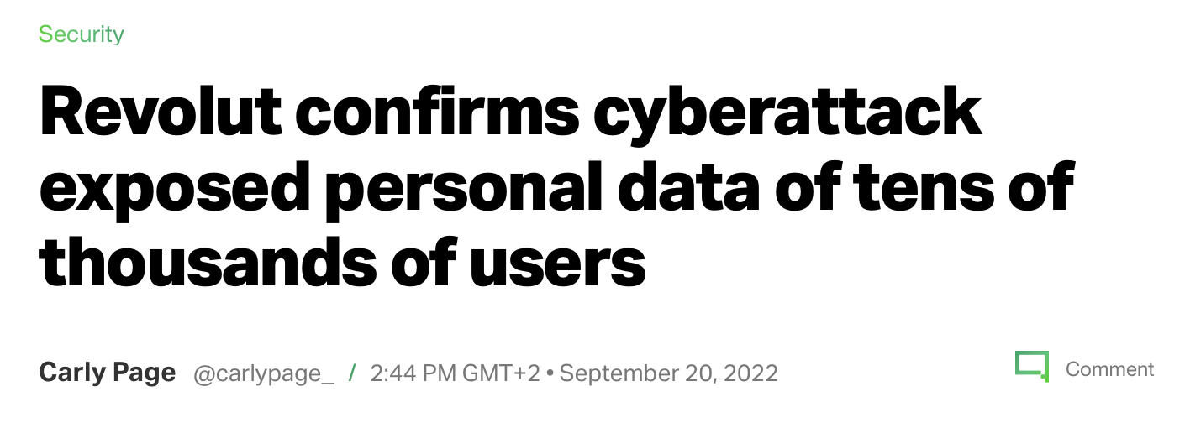
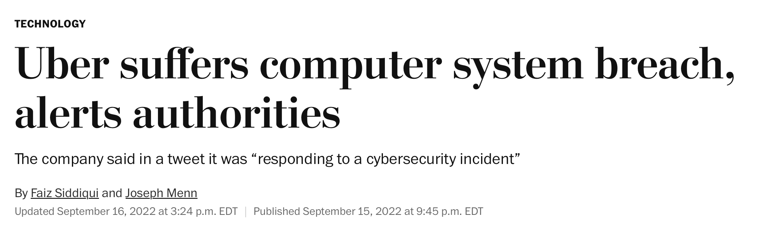
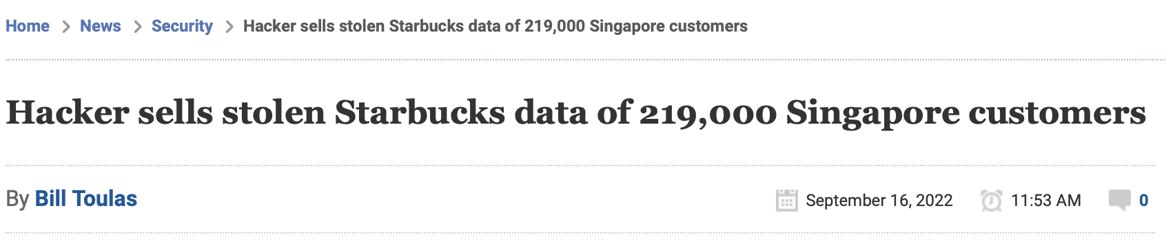
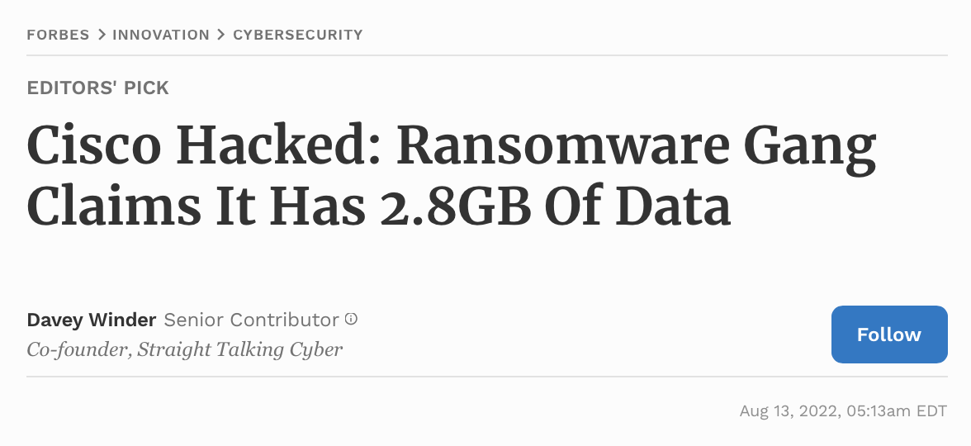
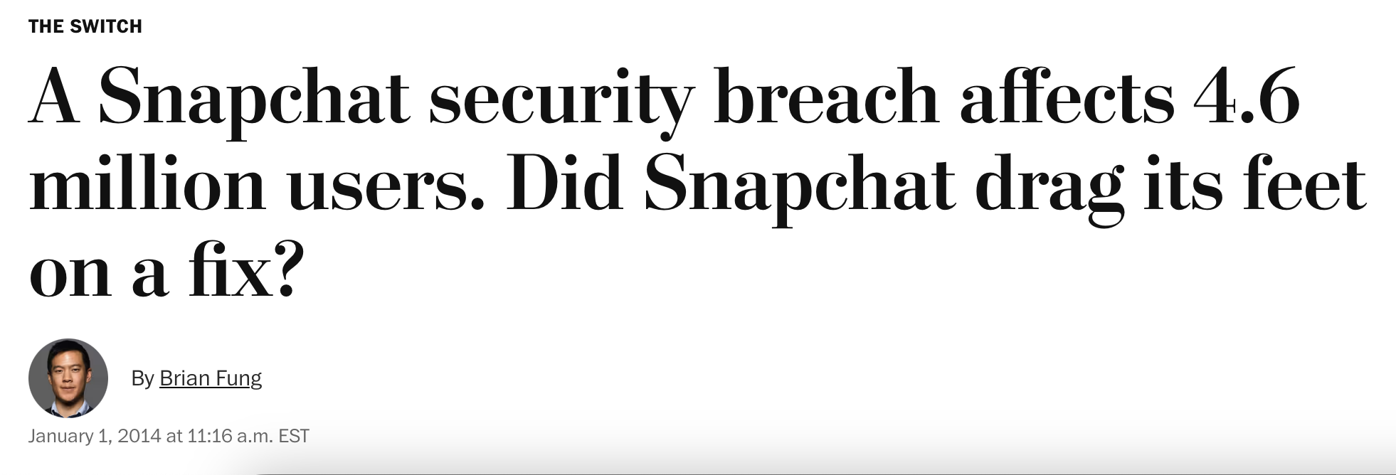
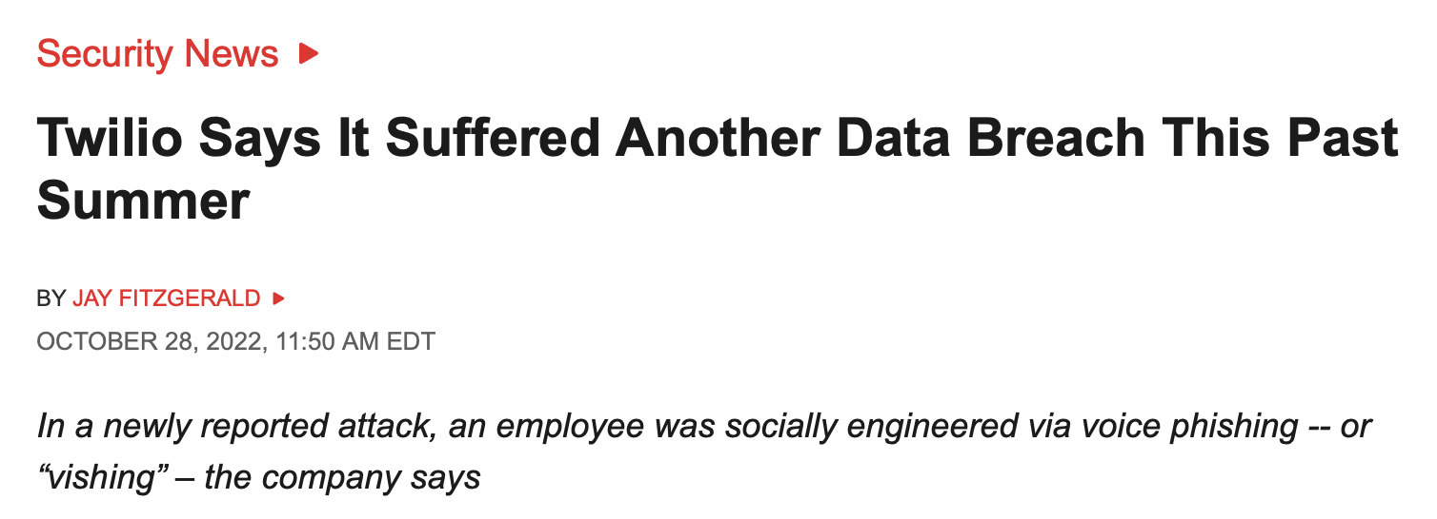
Danger Zone!
74% of all breaches include the human element¹
26% of incidents were caused by exploiting public facing applications²
13% of attack vectors were vulnerabilities in third-party software²
¹ Verizon 2023 Data Breach Investigation Report
² 2023 IBM X-Force Threat Intelligence Report
Notes:
Human element: (error, privilege misuse, use of stolen credentials or social engineering)
Everyone confronted with these news, no one wants to be in the headlines with such infos

Slide 5



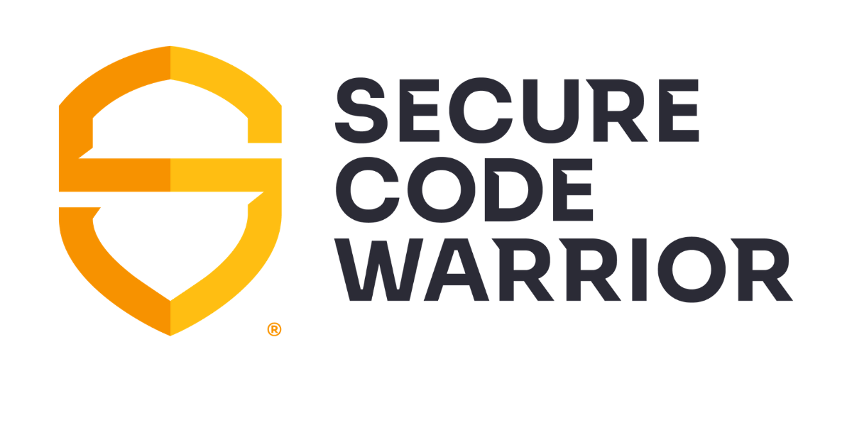


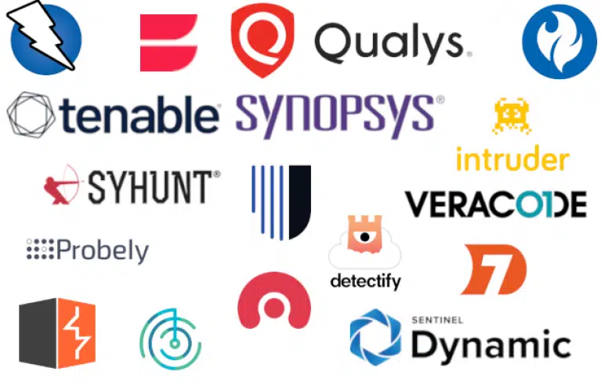
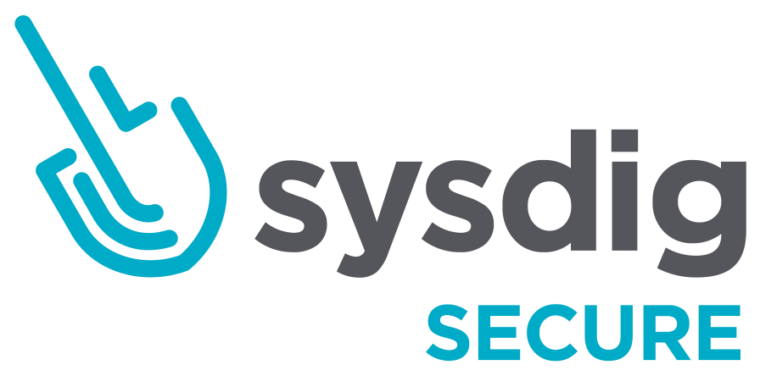




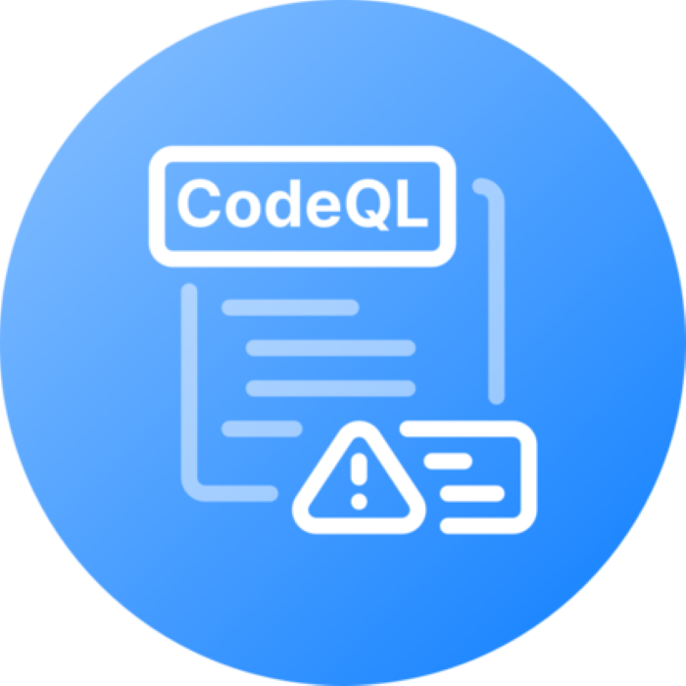














Let‘s Buy some more tools
Architecture review
Technology and framework decisions
Project roadmap
Business value and requirements
Configuration management
Infrastructure provisioning
Deployment strategy
Build
Monitor
Code development
Unit tests
Scaling and configuration
Bug and issue management
Reporting on KPIs
Code
Operate
Plan
Test
Design
Deploy
Branching strategy
Build application
Artifact management
Performance monitoring
Infrastructure monitoring
Integration tests
E2E tests
Performance tests
Notes:
PMs, Pos, …all start thinking about what they can do about it? Buy more tools!
What do deevs usually do? What security activities should be embedded -> what tools one can buy (SCA, SAST, DAST, Sboms, Containers scans…RASP) what are these tools used for? -> Plenty of choices

Slide 6












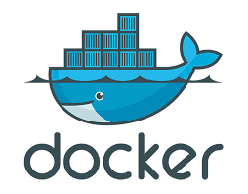











Gotta Catch 'Em All
Architecture review
Technology and framework decisions
Project roadmap
Business value and requirements
Configuration management
Infrastructure provisioning
Deployment strategy
Build
Monitor
Code development
Unit tests
Scaling and configuration
Bug and issue management
Reporting on KPIs
Code
Operate
Plan
Test
Design
Deploy
Branching strategy
Build application
Artifact management
Performance monitoring
Infrastructure monitoring
Integration tests
E2E tests
Performance tests
Notes:
PMs, Pos, …all start thinking about what they can do about it? Buy more tools!
What do deevs usually do? What security activities should be embedded -> what tools one can buy (SCA, SAST, DAST, Sboms, Containers scans…RASP) what are these tools used for? -> Plenty of choices

Slide 7

SecuritY
Development
Notes:
In the meanwhile People buy tools, the collaboration between security and development has seen better times
Metrics differ!
Team responsibilities are not coinciding

Slide 8
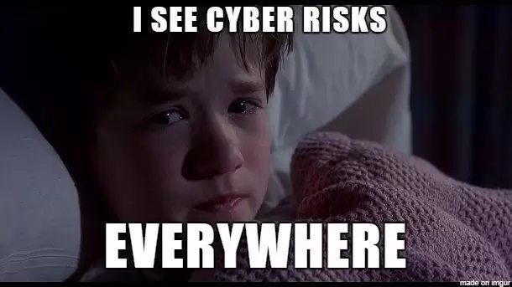
Notes:
With the approach security is often perceived as a blocker to the development work

Slide 9

Developers Must comply with all security policies I assigned them
But That’s none of my business
Notes:
Compliance approach to security
Tick in the box
Tools are very much helping with this, but not adding any real value

Slide 10
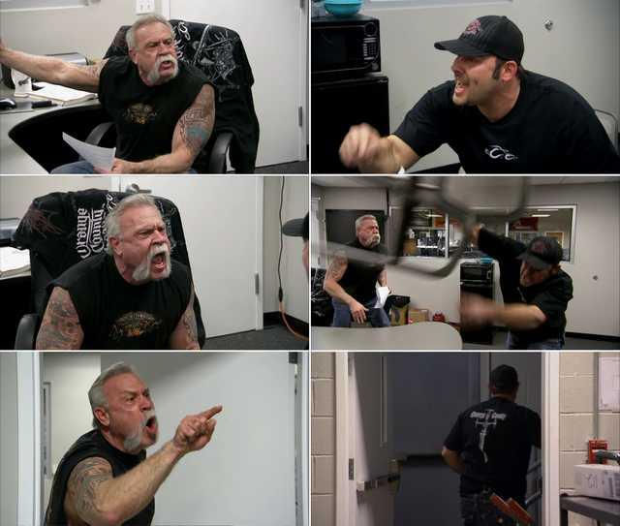
fill out the excel with the Open status of the security tickets
We track our tickets in Jira
I will not update the status Excel
We are using Excel!
I’m cc-ing my manager
Notes:
Human element: (error, privilege misuse, use of stolen credentials or social engineering)

Slide 11
You cannot buy devsecops
Collaboration culture
Awareness & Training
Secure the SDLC
Security experts embedded in development team
Clarification of success metrics
Align on security priorities
Foster a security mindset among stakeholders
Establish security champion program
Train developers on security
Take security into consideration in each step of the SDLC
Act on priorities and define security activities

Slide 12
Where to get started
Application profiling
Security requirements
Architecture and design review
Threat modeling
Application packaging
Configuration management
Secrets management
Build
Monitor
Secure coding guidelines
Security libraries
Code reviews
Runtime application security protection
Vulnerability scanning
Code
Operate
Plan
Test
Design
Deploy
Software composition analysis
Container scans
Image signature
Abuse case definition
Security incident & event management
Static application security tests
Dynamic application security tests
Penetration tests

Slide 13
Adding one tool at a time
Train developers
Set baseline
Manage findings
Clarify scope and goal of the tool
Enable developers to manage findings
Align on security priorities
Scan existing code base
Finetune scans
Create meaningful quality gates
Integrate tools with existing ticketing system
Prioritize findings
Visualize necessary work

Slide 14



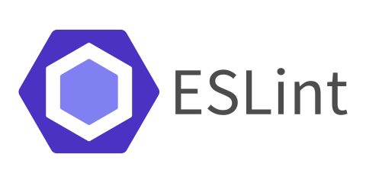


Introducing SAST
Source code repository
CI/CD pipelines
Vulnerable web application: OWASP Juice Shop ¹
Application hosted in GitHub ²
¹ Copyright © by Bjoern Kimminich & the OWASP Juice Shop contributors 2014-2023
² https://github.com/jasminmair/sast-test-juice-shop
Linting
Software composition analysis
Static application security test
BSides Munich 2023 - 7 SYNs

Slide 15
Baseline scan
Run a first manual scan
Create YML files for GitHub Actions
Set triggers to scan codebase
Create baseline scan and evaluate
Tool | Critical | High | Medium | Low | Total
CodeQL | 19 | 92 | 8 | 0 | 119
Snyk | 5 | 46 | 54 | 222 | 327
Bearer | 0 | 27 | 32 | 0 | 59

Slide 16
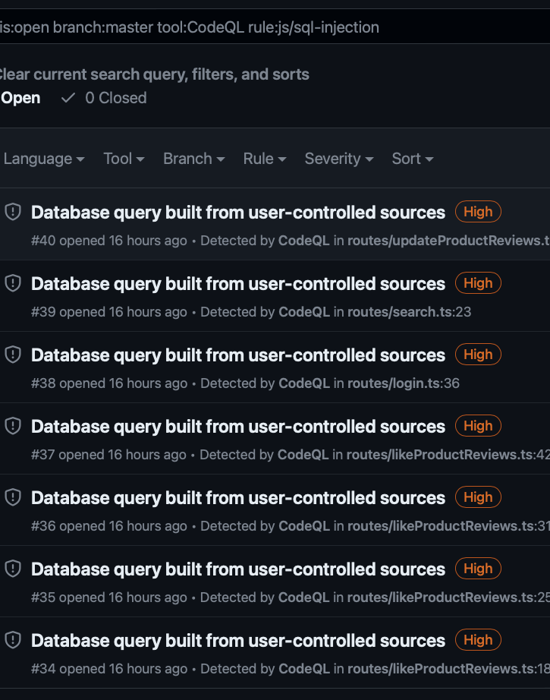
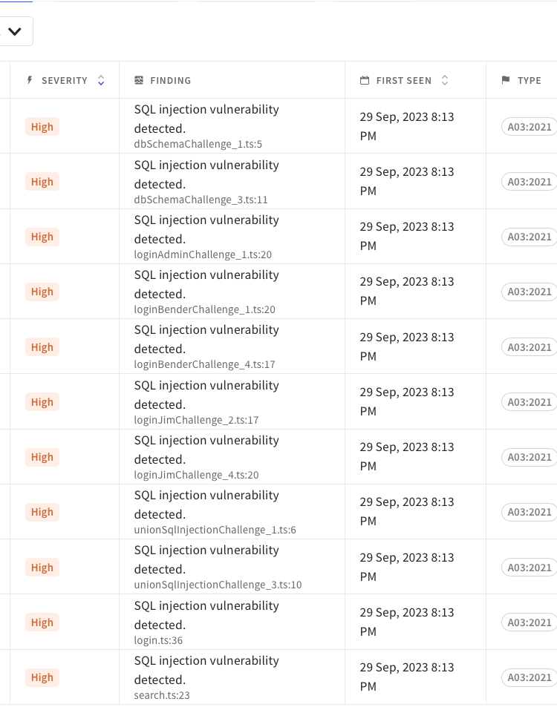
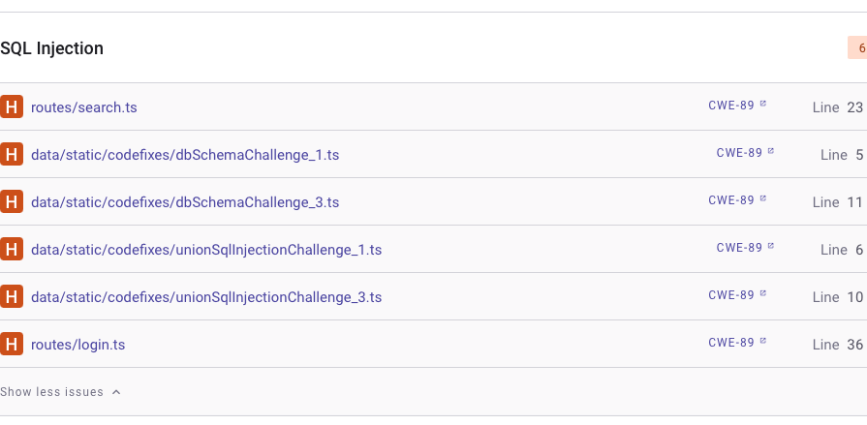
Inspect findings
How many injection flaws?
7
11
Prioritize findings based on the severity
Assess false positives & false negatives
Cluster findings by vulnerability type or CWE¹
Identify affected endpoints and areas of the application
¹ Common Weakness Enumeration https://cwe.mitre.org
6

Slide 17
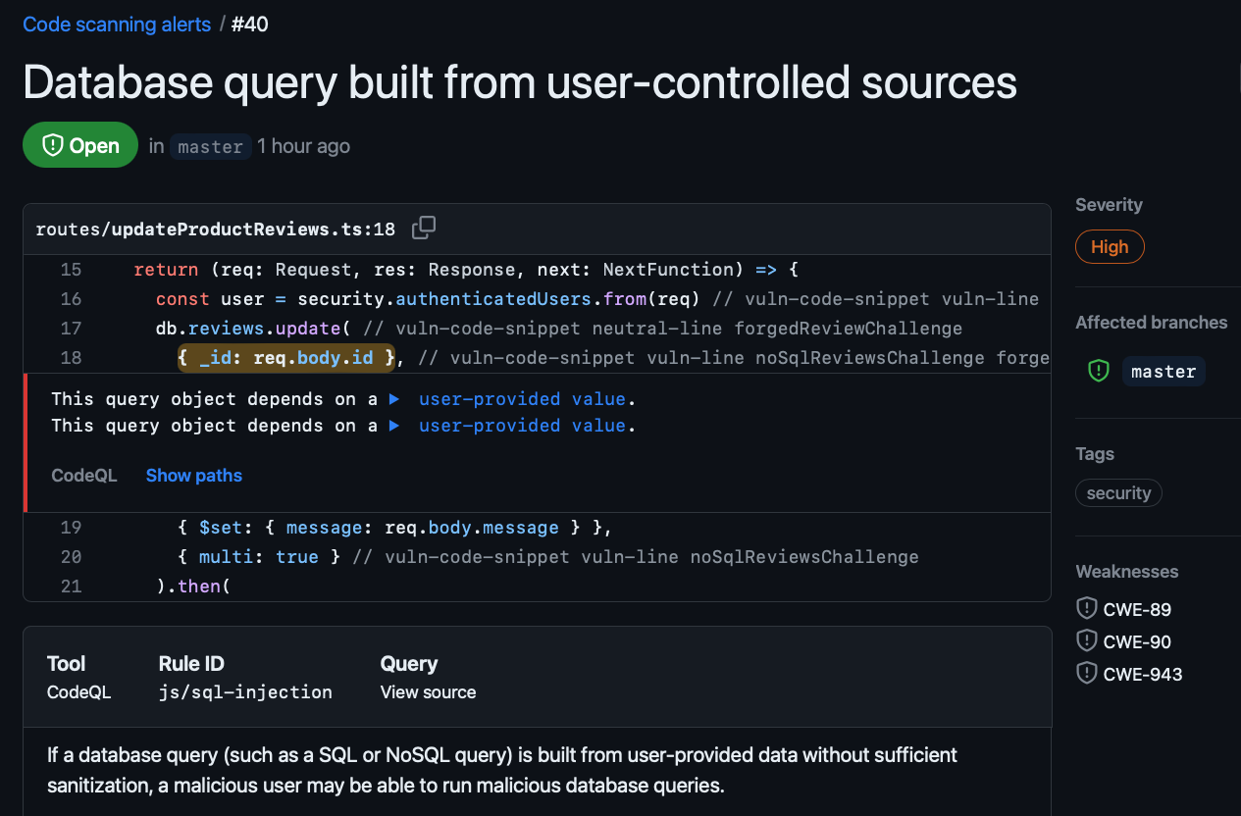
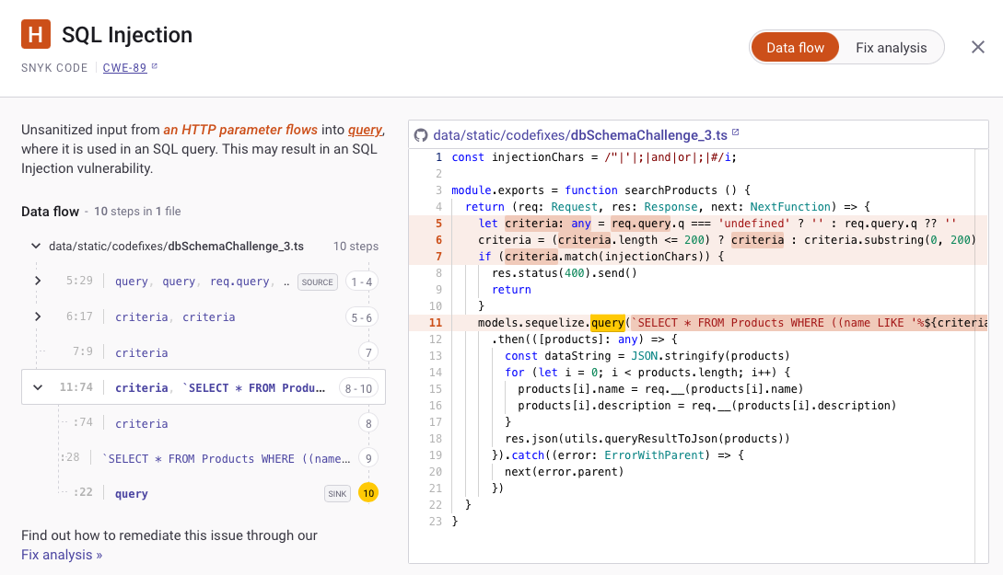
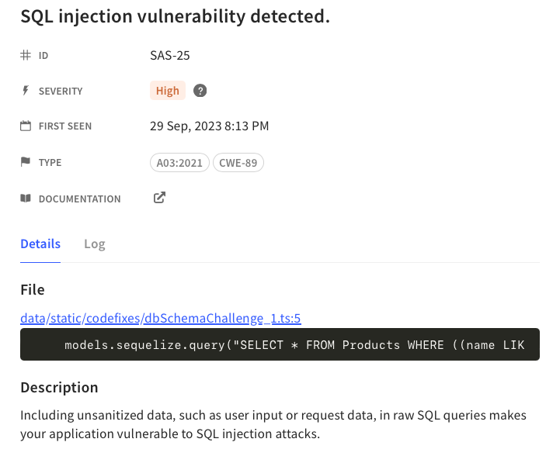
Tools are complex
Notes:
Different Uis, complex ways of working with the tools

Slide 18
What to do with findings?
Select a vulnerability
Fix vulnerability in code
Create Quality gate
Select the highest priority vulnerability/flaw in the application to fix
Decision is joint between business, development and security
Raise awareness on the vulnerability
Train developers on how to mitigate the vulnerability
Fix the vulnerability in the code while running SAST tool in the pipeline
Create a first quality gate in the pipelines to break the build if the vulnerability is identified again
Select next vulnerability class and restart the process

Slide 19

Secure PRoducts
Development
Security
Notes:
Human element: (error, privilege misuse, use of stolen credentials or social engineering)

Slide 20

THANK YOU
Jasmin Mair
jasmin.mair@owasp.org

