Slide 1
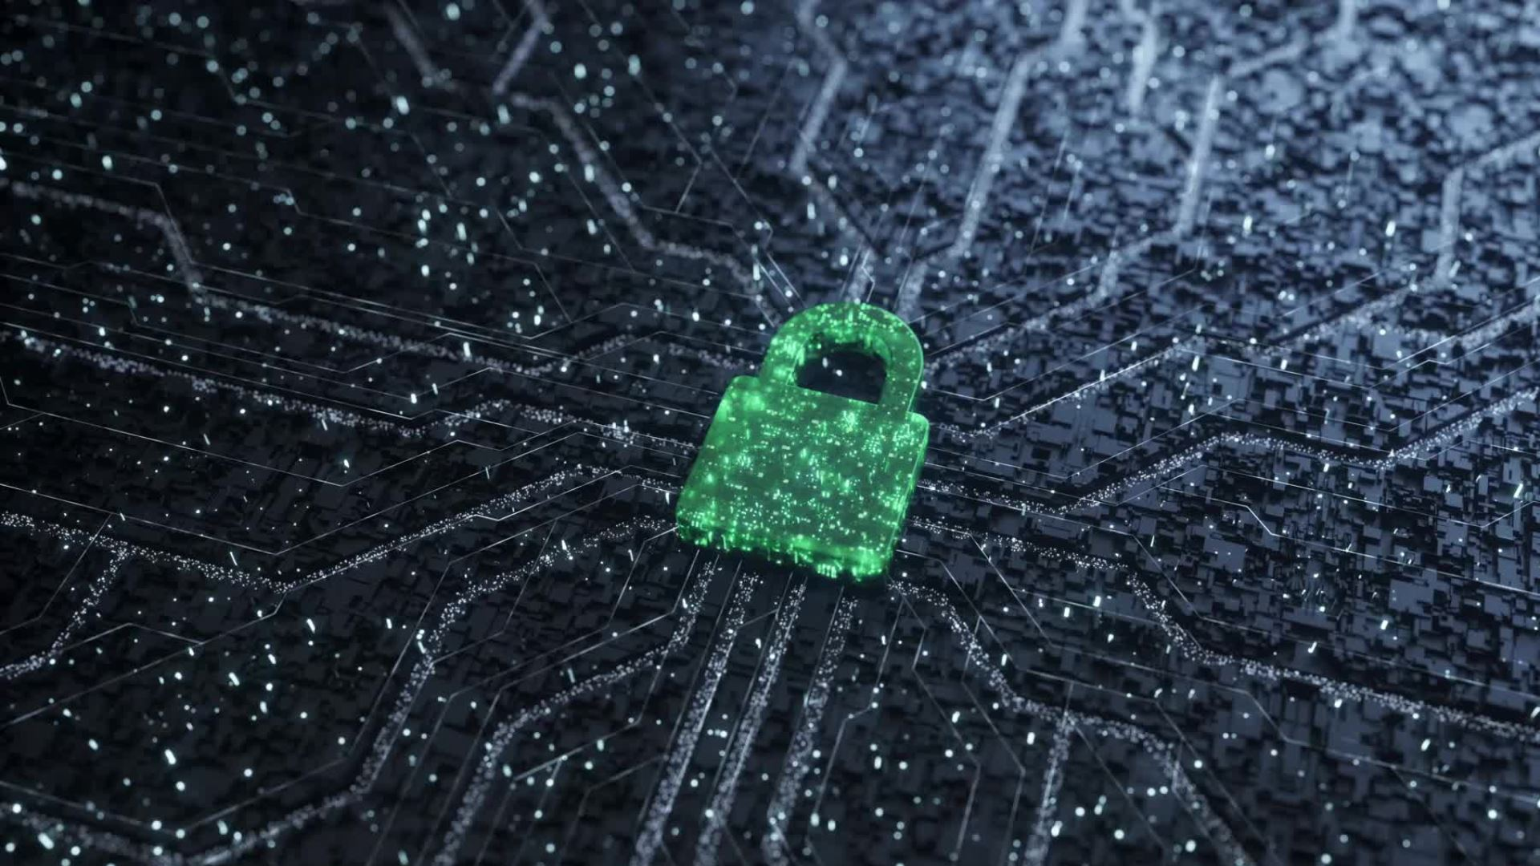
BIO-LOCK
IS DNA CRYPTOGRAPHY THE ANSWER TO DATA PROTECTION AND STORAGE?

Slide 2
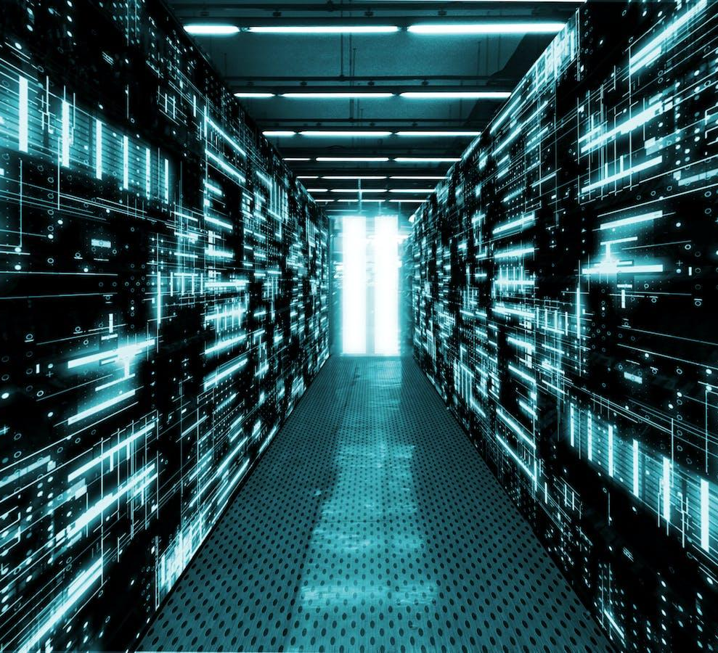
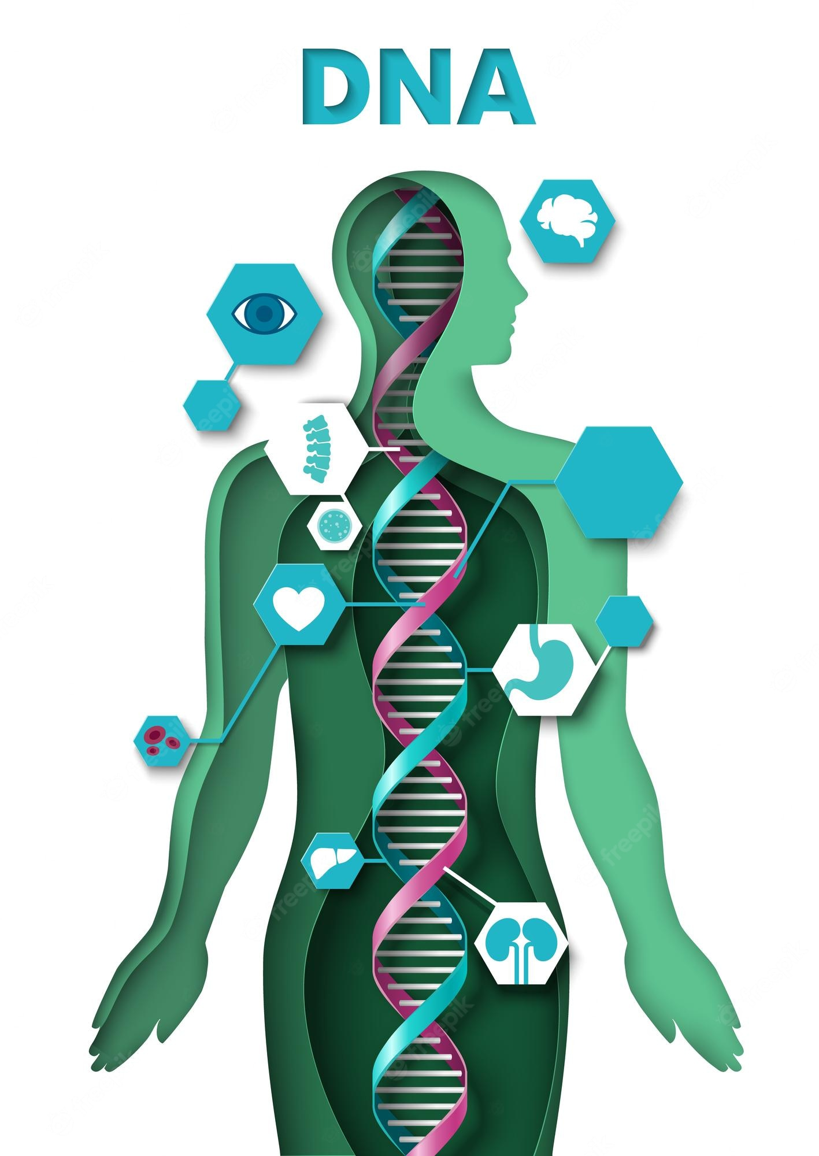
FOCUS OF TWO. QUESTIONS OF MANY.
This talk will focus on two areas
1.DNA cryptography for the purposes of data storage
General data storage
As a means of boosting current algorithms
2. DNA cryptography for the purposes of personalised encryption
The future possibilities
The ethics and potential pitfalls

Slide 3
WHY IS THERE A DESIRE TO USE DNA CRYPTOGRAPHY
Computational power will evolve
We can rely on the current math in place
Alternative have been suggested : Elliptic and DNA cryptography
Quantum and Elliptic has still been proven to be prone to PitM and Dos Attacks

Slide 4
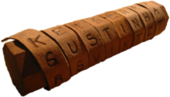
WHAT IS CRYPTOGRAPHY ?
The study of secure communication techniques
Two terms that are not interchangeable : Encryption & Encoding
Encrypting data is secure , encoding data is not secure
Encryption is a referred to as a private process among parties who know the secret
Encoding is an easily reversible process ,publically available schemes are used. (Base64 vs AES 256)
Cryptography is heavily influenced by our assumptions of what the current computational hardness of something this
As computers improve our strength of the given algorithm will need to change.
Encryption & Decryption is dependent on one or more keys
Ancient Greek Scytale / Caesar cipher/ substitution cipher

Slide 5
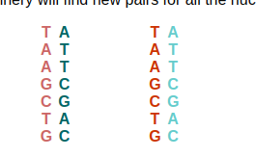
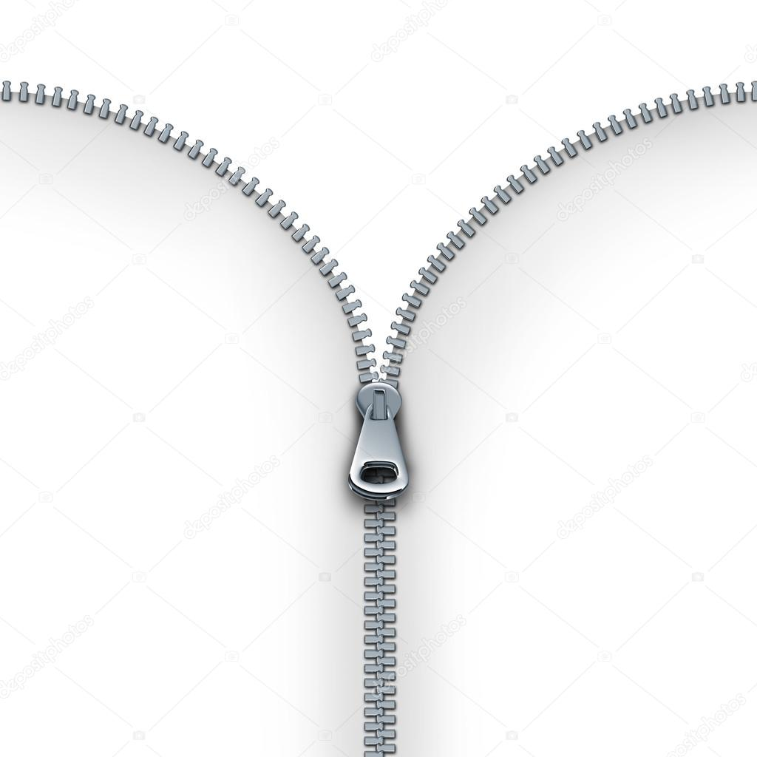
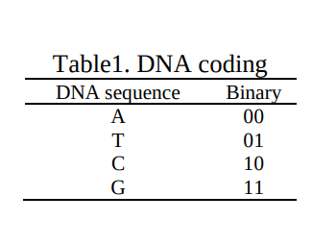
WHAT IS DNA ? HOW IS IT CONSTRUCTED
DNA COPYING ITSELF
Described as a long chain of molecules
DNA by its very design , has been used to store information about us that is millions of years old
Each molecule gives us information about how a living organism is constructed
4 molecule types
Adenine (A), Thymidine (T), Guanine (G), and Cytosine (C)
DNA is made up of two strands (think of a zipper that meshes together)
Base pairs : A =T G=C
Information is usually read in base pairs as DNA is double stranded
Encrypting data through a DNA sequence
TWO STRANNDS WORKING TOETHER

Slide 6
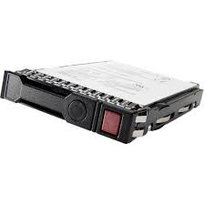
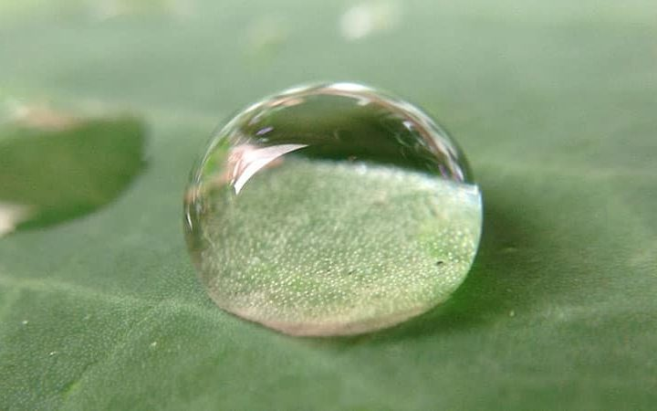
WHY USE DNA CRYPTOGRAPHY FOR STORAGE ?
Biological data from public databases is used to encode information.
Memory cards and chips are sustainable for 5 years from their preliminary use. Could eliminate these issues.
DNA is used information carrier
DNA has a large storage space.
One gram of DNA contains 1021 DNA bases which are equivalent to 108 TB of data. Hence can store all the data in the world in a few milligrams.
Large enough to store algorithms that are incredibly complex.
Could be used in combinationation with JPEG zigzag encoding and an encryption scheme to improve security in cloud enviromnts
HP 108 terabyte hard drive vs a rain drop
DNA molecular computers have a low power consumption, compared to traditional computers.

Slide 7
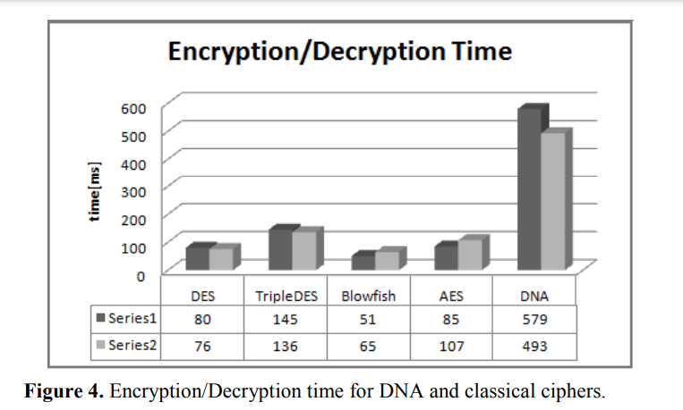
RELATIVE TIME TAKEN TO ENCRYPT (POSSIBLE PITFALL)
Length of time exists because the kind of data is different
Bytes vs strings
Hammad, B.T., Sagheer, A.M., Ahmed, I.T. and Jamil, N., 2020. A comparative review on symmetric and asymmetric DNA-based cryptography. Bulletin of Electrical Engineering and Informatics, 9(6), pp.2484-2491.

Slide 8
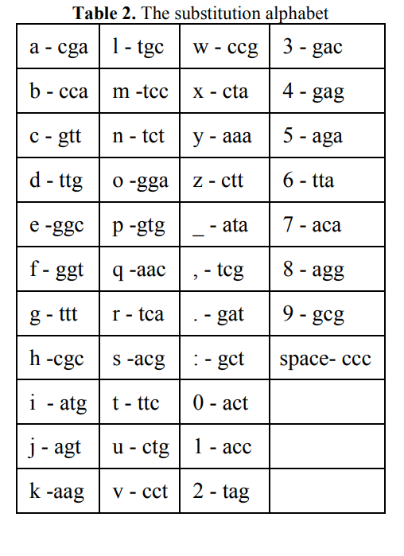
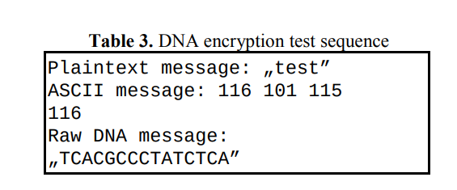
HOW IT WORKS
Using normal JAVA implementation with SDK
Substitution cipher is transformed into byte array with key
Substitution alphabet is publically known but the secret key is never known
2. BIO JAVA implementation with API
Several more steps
Use get_bytes() method which returns an 8 bit ASCII string for every character we want to encrypt

Slide 9
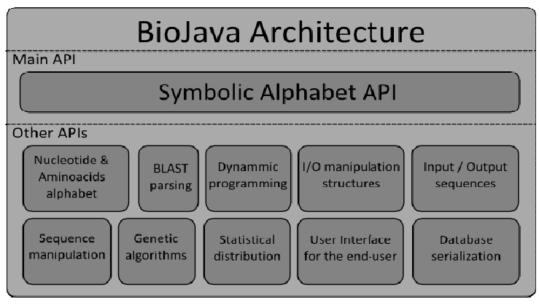
DNA SYMMETRIC CRYPTOGRAPHY
Java Implemetation
First DNA symmetric algorithm was implemented in Java language
Proceeded by algorithms written in BioJava and Matlab (API used for processing biological data
JCE (Java Cryptography Extension)
3 step process keygen , encrypt , decrypt)
OTP and substitution cipher

Slide 10
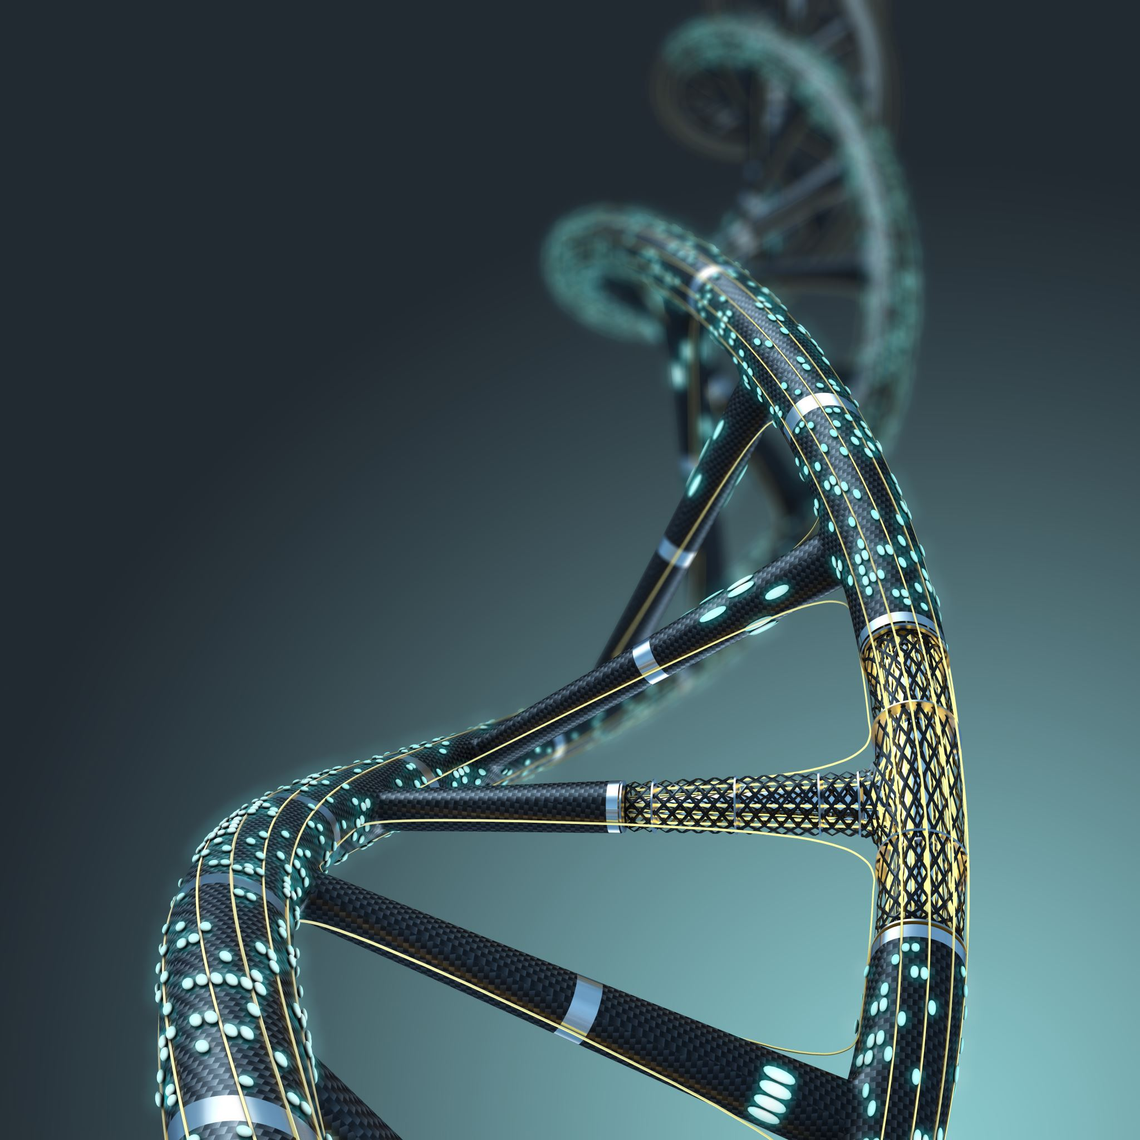
DNA SYMMETRIC CRYPTOGRAPHY
(USING OTP ALGORITHMS)
One key is used for encryption and decryption
DES, RC2, 3DES
Plaintext data is combined with random key or pad (XOR operation)
Terec, R., Vaida, M.F., Alboaie, L. and Chiorean, L., 2011. DNA security using symmetric and asymmetric cryptography. In The Society of Digital Information and Wireless Communications (Vol. 1, No. 1, pp. 34-51). Piscataway, NJ, USA: IEEE.

Slide 11
ASYMMETRIC DNA CRYPTOGRAPHY (RSA)
Researchers wanted to fix impersonation of key authorities
Remove the interaction that the user has with key authorities
2 keys (Public key to encrypt and private key to decrypt
Computationally intensive in comparison

Slide 12
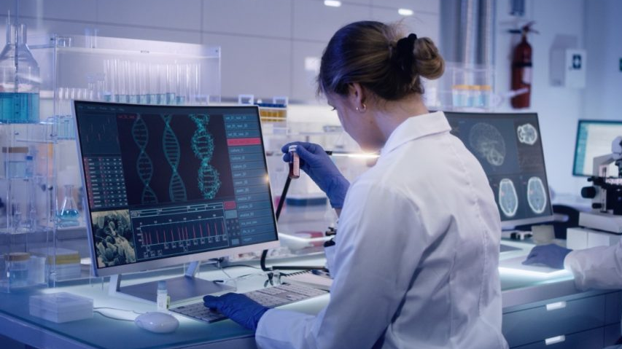
DNA STORAGE PITFALLS
Incredibly expensive (high risk of DNA contamination and data leakage if done incorrectly)
Lacking research (Limitations on biotechnology)
Specialist skills and laboratories required
At present being tested and used in military encryption contexts
Achievable streamline method needs to be created

Slide 13
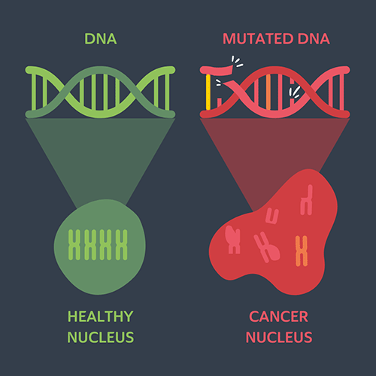
PERSONALISED DNA ENCRYPTION
Can we use our own DNA to encrypt our personal data?
Would be possible but several pitfalls come into the fold
DNA can change due to disease (hepatitis and cancer treatments)
Identical twins have the same DNA
The technology is still expensive and still very behind for personal use

Slide 14
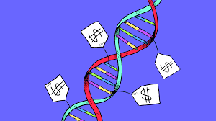
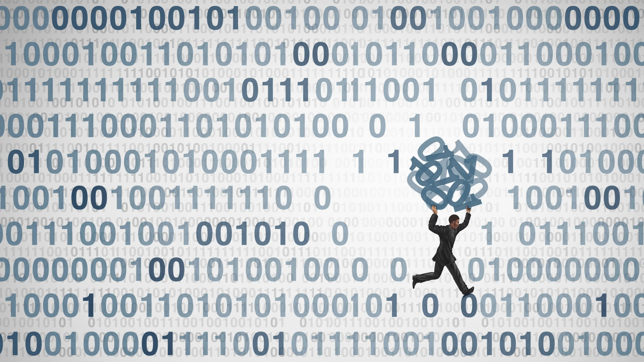
The ethics around using our own DNA
IF it were possible , would we even want it?
We have issues selling our digital selves to companies , what about our physical selves?
If data breaches occur , can our DNA sequence be stolen?
On the other hand…
Our DNA is EVERYWHERE

Slide 15
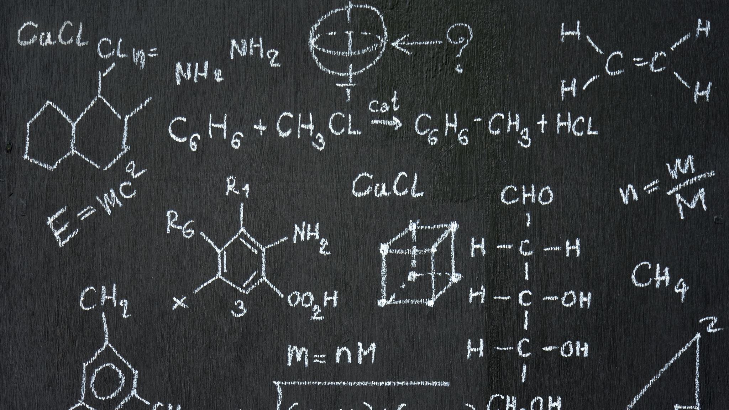
REFERENCES
Gehani, A., LaBean, T., Reif, J., DNA-Based Cryptography. s.l.: DIMACS Series in Discrete Mathematics and Theoretical Computer Science, Vol. 54, and Lecture Notes in Computer Science, Springer, (2004)
Hammad, B.T., Sagheer, A.M., Ahmed, I.T. and Jamil, N., 2020. A comparative review on symmetric and asymmetric DNA-based cryptography. Bulletin of Electrical Engineering and Informatics, 9(6), pp.2484-2491.
Techateerawat, P., A Review on Quantum Cryptography Technology, International Transaction Journal of Engineering, Management & Applied Sciences & Technologies, Vol. 1, pp. 35-41, (2010)
Adleman, L. M., Molecular computation of solution to combinatorial problems, Science, 266, 1021-1024, (1994) 8
Genetics Home Reference. U.S. National Library of Medicine. http://ghr.nlm.nih.gov/handbook/basics/dna. (2011) 9. DNA Alphabet. VSNS BioComputing Division, http://www.techfak.unibielefeld.de/bcd/Curric/PrwAli/node7.html#SEC TION00071000000000000000, (2011)
Terec, R., Vaida, M.F., Alboaie, L. and Chiorean, L., 2011. DNA security using symmetric and asymmetric cryptography. In The Society of Digital Information and Wireless Communications (Vol. 1, No. 1, pp. 34-51). Piscataway, NJ, USA: IEEE.

