Slide 1
Shielding Europe
DNS4EU: Pan-European Protective DNS Service for 100 Million Users
Andronikos Kyriakou | Tech Consulting Lead Tomáš Vogel | Threat Intelligence Analyst
Notes:
Hello everyone! My name is Andronikos Kyriakou and I am the Technical Consulting Lead at Whalebone and I am Tomas Vogel and I am a Threat Intelligence Analyst at Whalebone
Today we would like to open the discussion with you about DNS4EU and how we are planning to build & offer a protective DNS service to 100 Million users all around Europe.

Slide 2
$whoami
Andronikos Kyriakou
Tomáš Vogel
Tech Consulting Lead @Whalebone
Former member of SCYTALE Research Group where he researched Automation methods for the Deployment of Honeypots
Speaker at RIPE, BSides Athens
Threat Intelligence Analyst @Whalebone
Security researcher of (not only) end-user threats
Former public sector security analyst, CERT Incident responder

Slide 3
Agenda
What is Protective DNS?
The DNS4EU Project
Threat Intelligence
Applications of DNS4EU
Q&A
Notes:
During the presentation we will go over the scope of the project and it’s applications while the main focus will be on the Threat Intelligence aspect and our plans on how to build an actionable information sharing platform.
Furthermore we will discuss the applications of DNS4EU and how it can be offered to different end user segments and verticals.

Slide 4
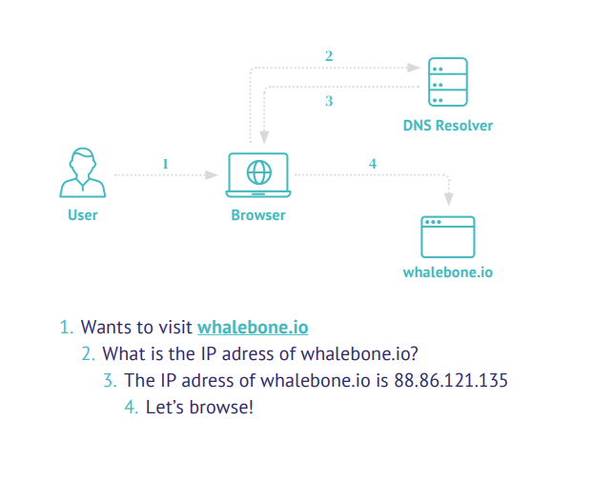
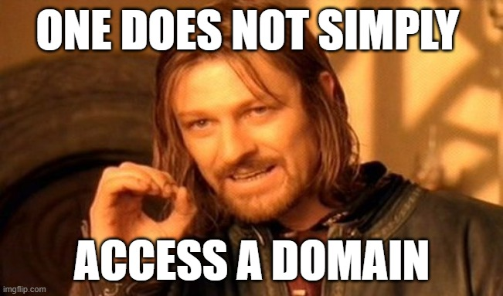
DNS Resolution 101
bsidesmunich.org
Wants to visit bsidesmunich.org
What is the IP address of bsidesmunich.org?
The IP address of bsidesmunich.org is 185.199.111.153
Let’s Browse!
bsidesath.gr
bsidesath.gr ?
Notes:
So first things first, let’s start with a bit of theory!
DNS resolution is the magical process of translating a domain name to an IP address.
Nevertheless. Whenever some process requests a network resource via a domain name, a DNS resolver is utilized and is responsible for fetching the results via iterating the DNS tree.

Slide 5
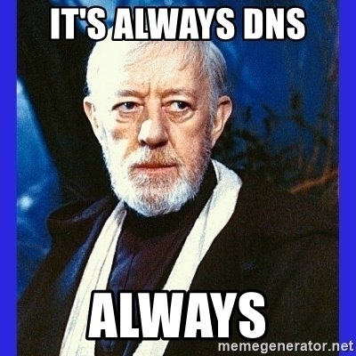
DNS Resolution 101
Defined in 292 RFCs (..and counting)
Agnostic of the OS and type of device
Disclaimer!
Critical Service
Notes:
Sounds simple right?
Well there some 292 RFCs that someone can read about it
What we have to say here is that this process is agnostic of the operating system or the type of device.
Someone can say that DNS is like the glue keeping the Internet together.
And at this point I would like to offer a moment of sympathy to all of us who have ever painfully troubleshooted any networking issue, only to come back to these wise words.
As you may have understood DNS is a critical service
But today’s talk is not about all the things that can go wrong with DNS but rather about how DNS intersects with cybersecurity.

Slide 6
DNS ∩ Cybersecurity
15B connected devices
94% of attacks rely on DNS
Notes:
Let’s consider the following facts
On the one hand nowadays there are 15B connected devices
This number is expected to grow to 24B by 2025
A security nightmare trying to protect each and every one of these.
Someone could ask? Is there any common denominator? Is there something we can apply at-scale?
Here the answer would be YES!
Industry-wide research shows that more than 94% of attacks rely on DNS at some point of the cyber kill chain.
Adding to the recipe the fact that all the devices regardless of their OS are using DNS resolution,
as defenders,
we have a unique opportunity to protect them at scale

Slide 7
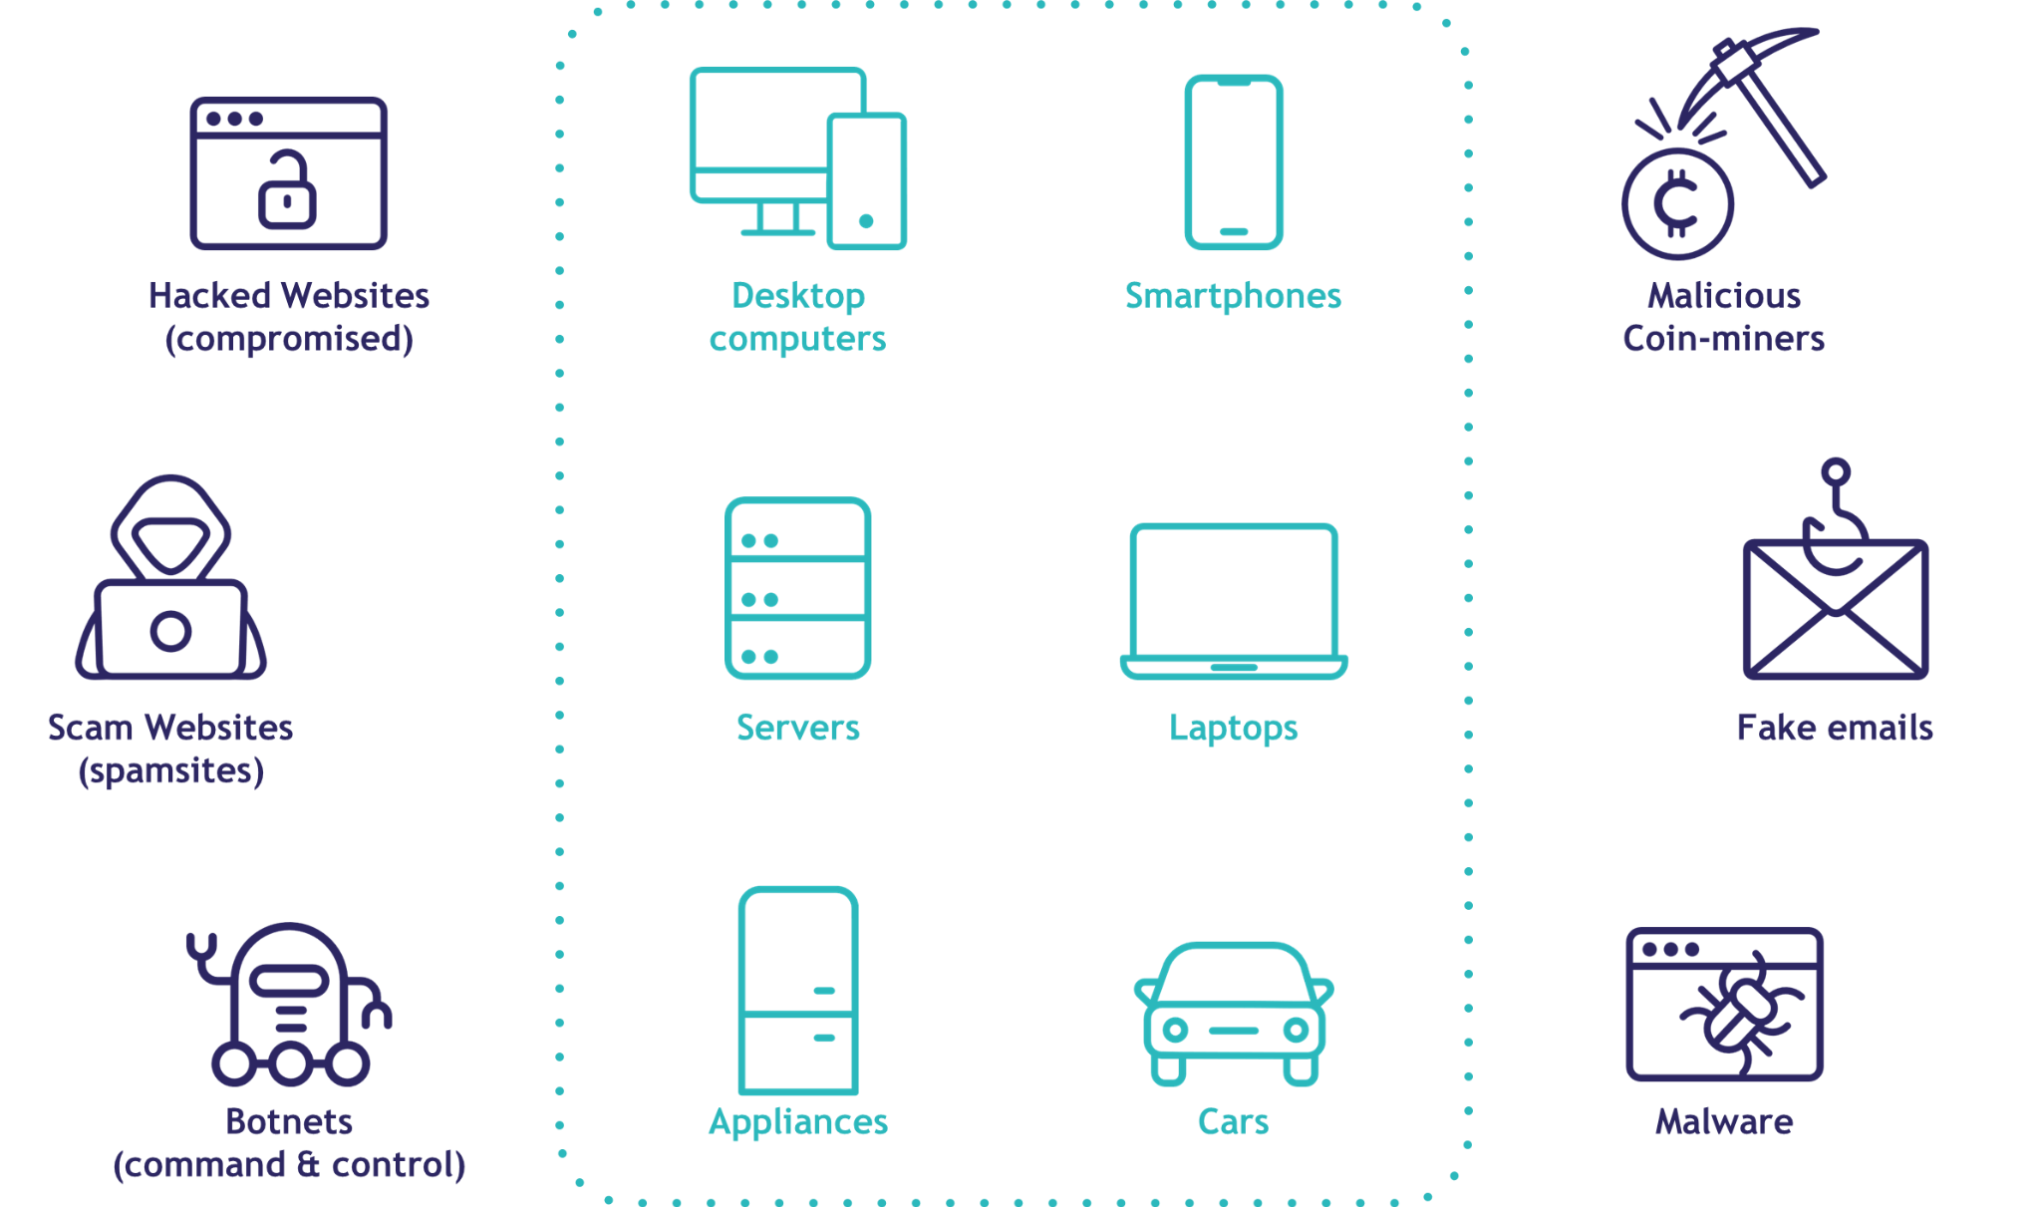
The rise of Protective DNS (PDNS)
Denying or obstructing attackers the use of domains can significantly reduce number of security incidents and improve early detection
phishing
malware hosting
C&C communication
Notes:
This reasoning gave birth to the notion of Protective DNS. What is protective DNS?
It is the viewpoint that DNS is no longer only protocol but can be considered a security service
Implementing a filtering of the DNS requests and blocking access to malicious domains is a really easy way to establish a first line of defense,
By blocking access to phishing websites, detecting malware communication, as well as providing real-time insights to the security teams the number of incidents can be dramatically reduced.
------------------------------ The main purpose of the protective DNS can be summarized as a reduction of attack surface while not disrupting comfort of the user.
- Our solution needs to be effortless for the users.
- That's why DNS was our choice - no installation, no update, no configuration. You're connected to the network - you're good to go
- It must make it as difficult and inconvenient as possible for adversaries
- DNS is still used in 95% of attacks - phishing, malware hosting, C&C communication.
- Denying them this option can largely reduce the attack surface - good luck making people click on an IP address link

Slide 8
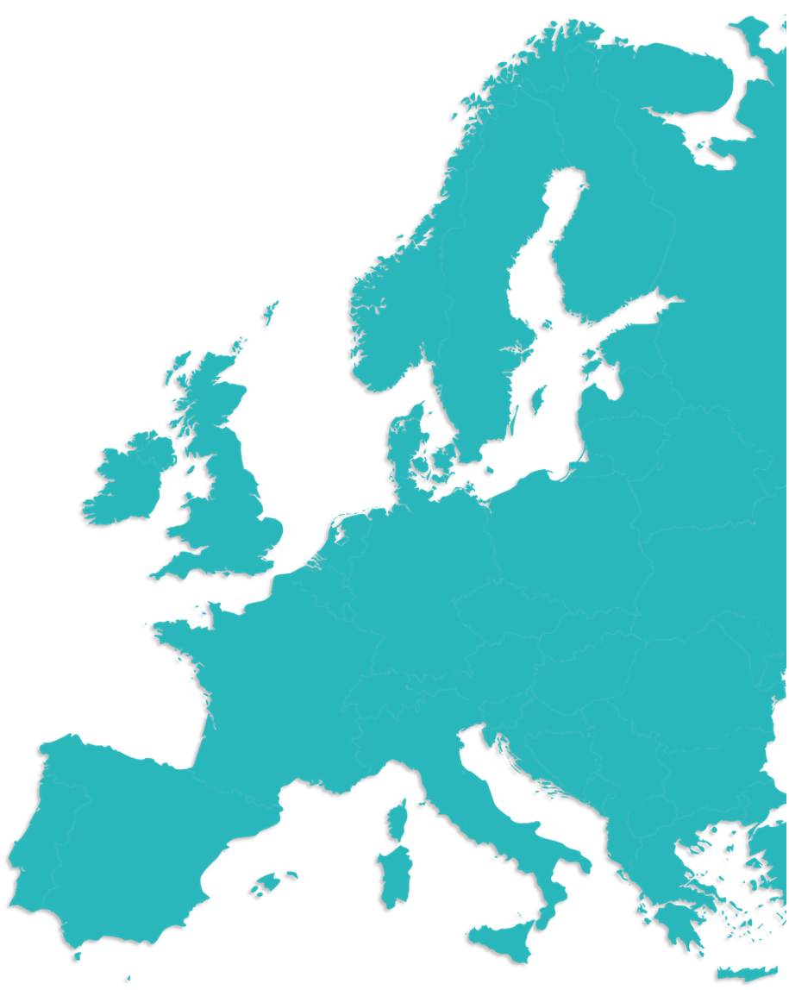
DNS4EU = secure, resilient
and private Internet
"...the deployment of a recursive European DNS resolver service (hereafter DNS4EU) serving socio-economic drivers, public, corporate and residential internet end-users in the EU, and offering very high reliability and protection against global cybersecurity threats and those specific to the EU (e.g. phishing in EU languages).
This is a key policy action announced in the 2020.“
Notes:
And here comes the main topic of today’s presentation which is DNS4EU.
In the slide you can see an extract from the original call for proposals.
The primary goal of the project is to build a European Protective DNS service which will improve resilience, protect privacy, and also foster cross-disciplinary collaboration
DNS4EU will have a strong security aspect and will offer protection not only against global, but also and more importantly against local cybersecurity threats.
As it is highlighted in the last sentence, this is a key policy action announced in 2020 in the Commission’s Cybersecurity Strategy for the Digital Decade

Slide 9
DNS4EU Consortium
Consortium Members
Associated Partners
Whalebone, s.r.o. (🇨🇿)
CZ.NIC (🇨🇿)
Czech Technical University Prague (🇨🇿)
Time.lex (🇧🇪)
deSEC (🇩🇪)
Sztaki (🇭🇺)
ABI Lab Centro di Ricerca e Innovazione per la Banca (🇮🇹)
Naukowa i Akademicka Sieć Komputerowa (🇵🇱)
Directoratul Național de Securitate Cibernetică (🇷🇴)
Ministry of Electronic Governance (🇧🇬)
CESNET (🇨🇿)
F-Secure (🇫🇮)
Centro Nacional de Cibersegurança (🇵🇹)
Notes:
Soon after the call was issued,
at Whalebone, we started building a consortium with members from different disciplines and nationalities.
In it final shape the consortium consists of 14 members originating from 10 different countries.
The members are a mix of Public and Private entities such as companies , Computer Emergency and Response Teams, NGOs. and National Research and Education Networks
In more detail, the members apart from Whalebone consist of: CZ.NIC, the registry of the .cz domain, the Czech Technical University based in Prague, the Belgian law firm Time.lex, deSec which is a German non-profit organization focused on DNS hosting the Hungarian and Polish CERTs
Abi Lab from the Fincancial CERT of Italy
and the National Cyber Security Directorate from Romania
Furthermore, we have included some associated partners such as Ministry of Electronic Governance from Bulgaria the National Cybersecurity Center of Portugal the antivirus company F-Secure from Finland
and CESNET from the Czech Republic
Each member of the consortium is adding its own expertise and contributing to the goals that have been set by the project

Slide 10
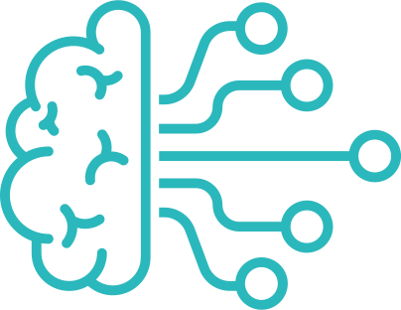
DNS4EU overview
Threat Intelligence
Intelligence generated based on the DNS4EU anonymized traffic
Regional intelligence exchange
DNS for Telcos
On-premise resolver for Telcos
DNS4EU Threat Intelligence
(DNS4EU shared IP)
DNS for Governments
Protective DNS for governments
DNS4EU Threat Intelligence
(DNS4EU shared IP)
DNS for End Users
Public DNS service
DNS4EU Threat Intelligence
DNS4EU shared IP
Notes:
Moving forward to the verticals of the project
DNS4EU can be summarized in 4 pillars: Threat Intelligence, DNS for Telcos, DNS for Governments and DNS for End Users.
The first case, which is a cornerstone of the project is the threat intelligence which will be generated and applied to all the deployment scenarios.
The threat intelligence will be the product of research based on the DNS4EU traffic as well as continuous information exchange.
More information will be shared right away by Tomas.

Slide 11
Threat Intelligence
Based on DNS4EU traffic
Regional intelligence exchange
Actual DNS4EU traffic will be analyzed for new threats and trends
DNS traffic trends will also be used for false positive mitigation
Mitigation of global threats
Refining the effectiveness of protection
Establishing (or leveraging existing) threat intelligence sharing platforms
Cooperation with local CERTs/CSIRTs and commercial entities
Immediate use on DNS4EU resolvers
Notes:
The threat intelligence pillar is a good starting point as this is the common denominator to all of the outlined scenarios.
It’s often ambiguous terms - in our case, it primarily means the technical indicators that we produce and evaluate, but it’s is also important as a research of the threats, as they constantly evolve and adversaries modify their tactics.
At WB we have a long history working with DNS protection and I would highlight two key aspects when it comes to it: the accuracy or coverage of emerging threats and the low number of false positives
— —- Current pillars of our threat intelligence are analyzing On a foundational level we will cooperate with existing threat intelligence providers and incorporate threat feeds in order to protect against the global campaigns. This is not something groundbreaking and such a protection layer is offered already by multiple public resolvers.
The important differentiator will be the regional threat intelligence which we are going to introduce. Our plan is to focus on each individual member state and target emerging threats such as phishing or smishing almost immediately.
In order to achieve that we will cooperate with the local CERTS and organisations and we will utilize new or established information sharing communication channels,
At the same time we are also aiming in refining the accuracy and uncovering new threats by analyzing the anonymized DNS4EU traffic.
What we aim to do is to exchange the information as soon as possible and immediately block the malicious domains on the DNS4EU level for 100 million users.

Slide 12
Threat Intelligence lifecycle
Early detection
Monitoring domain and certificate registration to catch the domain before it’s used
False positive mitigation
Evaluating the detection and continuously optimizing the process to minimize occurrence of false positive detections
Intelligence sharing channels
Reports and feeds of observed malicious domains from consortium members and connected institutions
Traffic analysis
Monitoring for patterns in the traffic to detect unknown malicious domains, DGA and DNS tunneling
Notes:
To give you a brief hint of the DNS4EU Threat Intelligence lifecycle
In additional to mentioned integrated feeds,our intelligence aims to recognize and stop malicious domains in their very beginning.
This means monitoring and evaluating new domain registrations and certificate transparency.
In this task, we are cooperating with the Consortium member Czech Technical university and NASK/CERT-PL on developing machine learning model on the data from national TLD domain registration - to deny the adversaries possibility to use convincing looking domains - no more .CZ, .DE, .GR
This aims to catch the obviously malicious or impersonating domain before they’re even used.
Also what we already have in place is monitoring for generally suspicious TLDs (top, xyz etc.)
Also in the first stage, the second key aspect is sharing of the threat intelligence
Collective effort not only of the Consortium, but all institution who want to participate - CERTs/CSIRTs and also commercial entities such as banks, retail and parcel delivery services.
To join and report malicious domains from their local threat and campaigns to be blocked for 100 million users.
The analysis of the actual traffic is also a vital source for detection, from which we can recognize malicious patterns from the traffic, fast (near real-time) evaluation of unknown and previously unseen domains.
This help with detection of otherwise problematic cases such as DGA domains, DNS tunelling and identifying weaponized parked domains that were registered a long time ago and suddenly started serving for malicious purposes
The last step of the cycle is the feedback - to prevent false positives and improve or tune the detection algorithms .
We aim to have number of false positives as close to zero as possible - on this task, we cooperate with our consortium member Stratosphere labs of Czech technical university.

Slide 13
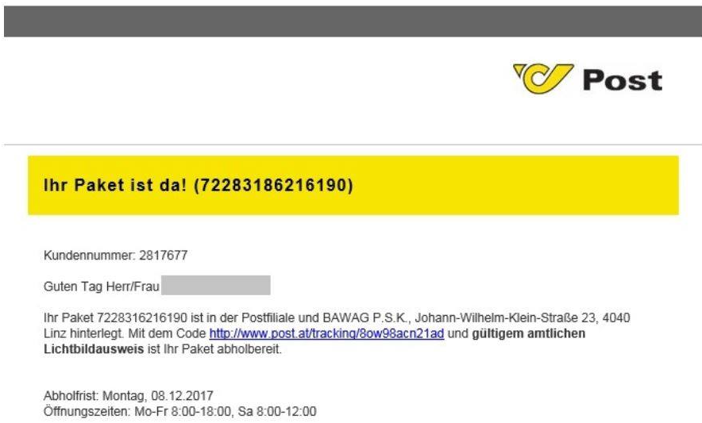
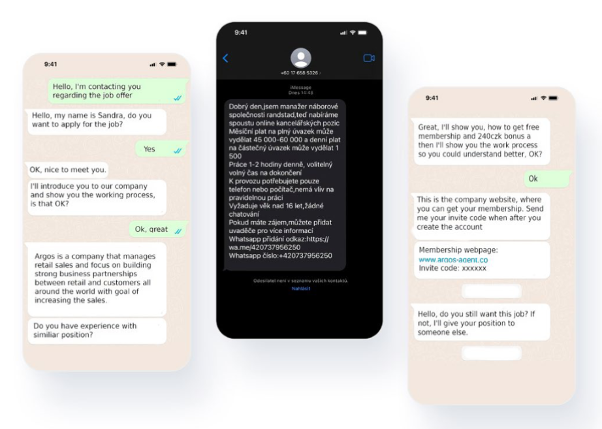
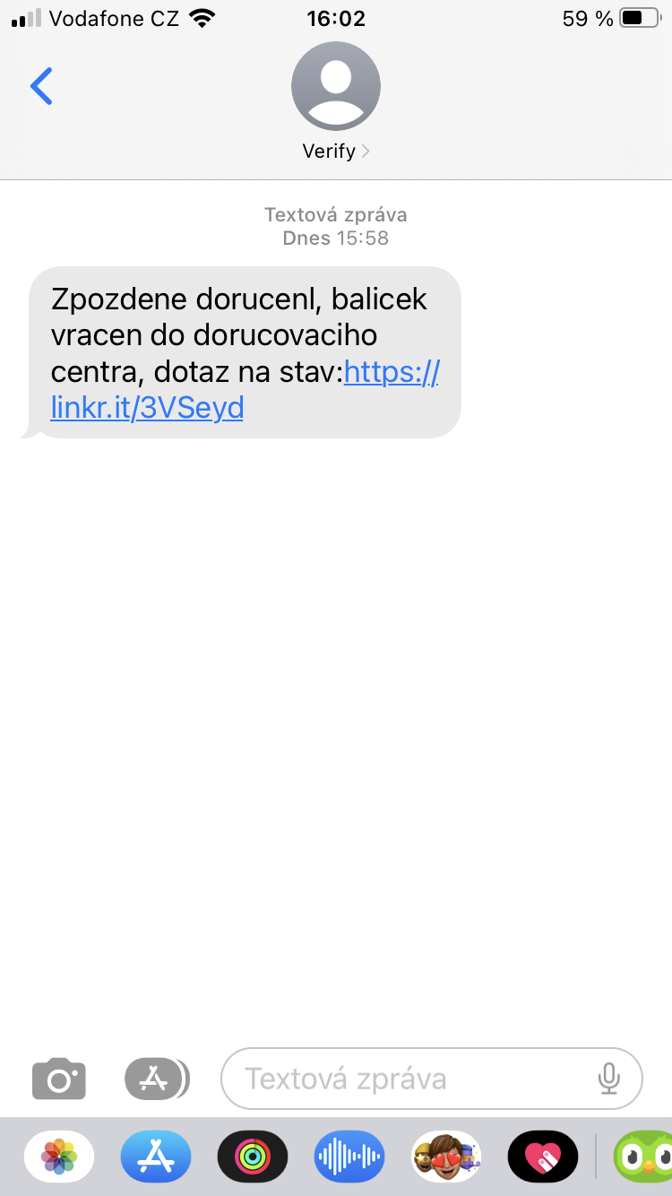
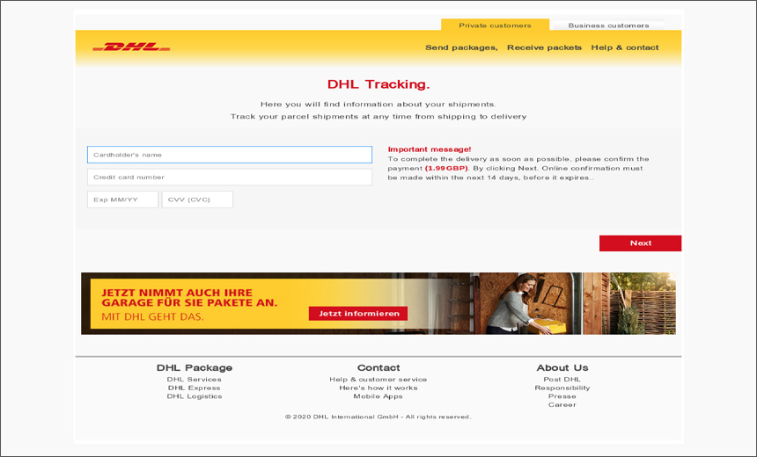
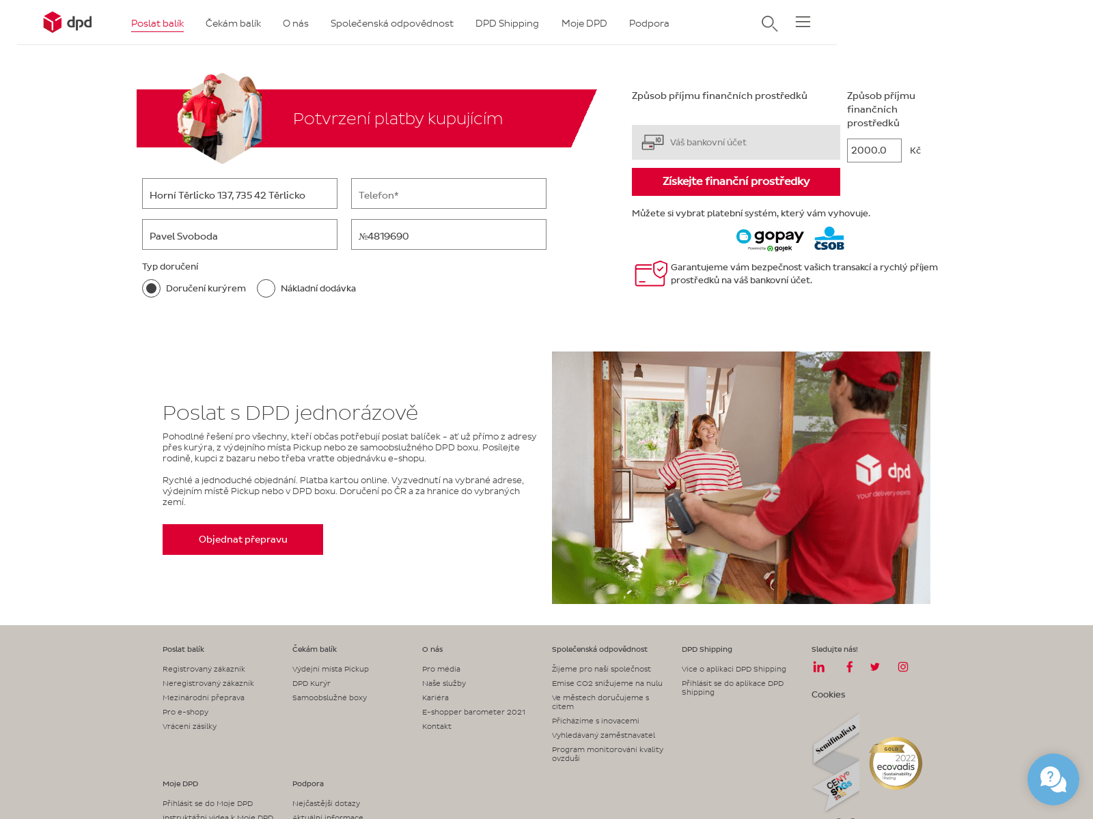
Cleaning the internet
Notes:
I’ve mentioned the threat intelligence sharing and as we considered the most important part, i’d like to dig at least a bit into it and explain why.
Let’s as an example look at what are the issues when dealing with local phishing campaigns and how we aim to help - It’s one of the most pressing threat against end-users. It’s a widespread issue, setting up a page like this and sending a mass message is very easy, quick and pretty much free.
We observe tens of thousands new phishing domains per week, generating 5-10 million blockations.
For example, in Czechia, the average damage caused by a successful phishing such a these is over 7500€ (161000Kč).
You all’ve probably seen some of those. Maybe even someone around you fell for it. And we really don’t like those and want to eradicate them.
Our experience so far has been that especially in the case of phishing, the organizations who are being targeted e.g. parcel delivery company, know from the very first minutes that their brand is being targeted and fake messages are being spread.
Same with Telcos, who can often observe that there’s ongoing sending of mass SMSs
But what can they do with it to protect the users from it?

Slide 14
Regional Threat Intelligence
Early detection system via collective effort
Obstacles when fighting phishing campaigns
Short lifespan
Impact limited to region means less detection
By the time it's take down, the damage is done
No central point to report
Notes:
Phishing and smishing campaigns like the ones mentioned earlier are a tough case for regular security solutions.
Short lifespan
Impact limited to region means less detection
By the time it's take down, the damage is done
sending abuse reports or notice to their customers usually don’t bring immediate results
Takedowns of domains usually take at least several hours - enough time for the attackers to achieve their objective and there's no central place where they can send it to be blocked - this will be the place for banks, retail and basically anyone who's a victim of an impersonation phishing to quickly report a domain and it can be blocked EU-wide within minutes.
As the DNS4EU aims to be the EU DNS shield intended to be available to 100 million users, it can offer the missing central point.

Slide 15
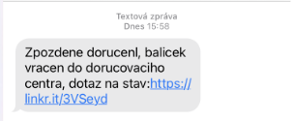
Anti-fraud detection synergy
1) New scam started! Domain: dpd-cz.merchant5344286[.]xyz
CT
2) Analyzing the campaign! New domains: zasilkovna-cz.merchant5344286[.]xyz ppl-cz.495021[.]online dpd-cz.delivery933[.]info dpd-cz.order0286[.]info …
NRD
DNS logs
3) Blocking the campaign!
Notes:
To find the first start of a phishing campaign, we found that best way is the synergy of Telco and our security. As the actors mostly rely on mass sending SMS, you can see them in your network and identify that this could be a malicious anomaly. And once reported to us, it gets blocked immediately. But now just that, but it also get plugged in our Bazaar system, that start looking for similar ones and block them proactively.
These may get caught already by some of our other detection systems, but sometimes they are created and used too fast.
But here’s where within Telco and Whalebone synergy becomes great at fighting these frauds and protecting the users in a precise way. Within your network, you can see quite early that mass fraudulent messages are sent out. And for example we have a cooperation framework that they alert us in such event, we check those domains in the initial set and block them immediately if not already blocked, but crucially, we feed them to our Bazaar that will start looking for similarities. Using the initial alert, we are now able to continuously block further attempts of the campaign and identify other domains that we send back to the threat database, proactively stopping the threat.

Slide 16
Threat Intelligence sharing
Sharing is caring!
DNS4EU will provide central place to block DNS threats for 100 Million people
Easy and automated connection
Public & Private sector
Notes:
That’s why we aim to provide and encourage a collective effort not only of the Consortium, but all institution - both public and private - to participate and share the reports of malicious phishing campaigns.
Connection methods
We want to make the process and options as simple and fast as possible for everyone.
What we don’t want to use are mails - he key is in speed an automation - reported domains must reach the resolver within minutes including the accuracy check on our side - this is what we are already putting into practice.
We will offer several ways and endpoints.
Lets look at one of them

Slide 17
Threat Intelligence sharing
MISP - Malware Information Sharing Platform
European standard
Dedicated DNS4EU instance operated by Whalebone
Push synchronization - sharing only necessary, relevant indicators
Direct pipeline into the resolver
Notes:
We chose MISP as that main tool for the job
For those who don’t know about the project - MISP is an open source security information sharing platform developed by Luxemburg CIRCL and growing community of volunteer. So a fitting European solution for european protection.
It's becoming an industry standard for both public and private sector, it’s well documented, easy to deploy and connect with other servers.
It’s key power lies in the way it works with the information - In addition to the indicators themselves, MISP is also great for providing context with description and tag, giving us possibility for deeper analytics and correlations of the threats.
It also offers very granular setting to sharing, leaving you full control who sees the data and it’s context
Whalebone will run a dedicated instance for the DNS4EU so those who use can easily join and
Connecting via MISP will enable simple, automated and real-time sharing of indicators, on our side connected to the resolver.
We are aware that not everyone uses MISP, so we'll also provide alternative channels:
RPZ and dedicated API
Call to action
contact us for sharing opportunities - how to join.
join mailing list

Slide 18
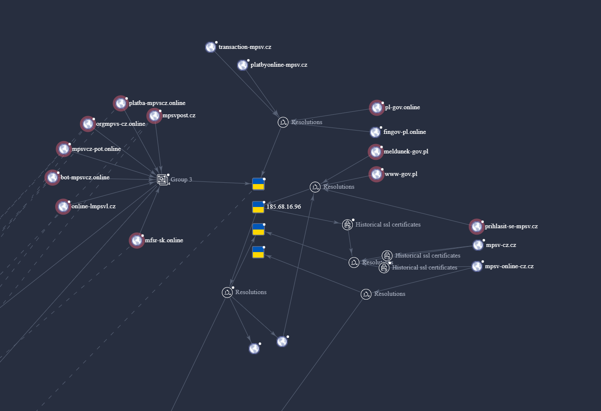
EU-wide correlation intelligence
Notes:
One bonus point on why sharing is important
It’s not just about blocking - It can draw the adversaries into the spotlight
- Information and indicator from local frauds and phishing campaigns are often not shared cross border - as they are considered a local issue and others are not impacted by it, therefore it seemingly doesn't provide a direct value
- But these campaigns are often operated in multiple countries at once by the same actor
- The DNS4EU can provide a place where the individual campaigns can be seen in their whole context, connecting the dots between them.
- This can make it easier to take down not just the domains, but those behind them.
In this example from end of last year, we can see part of an infamous phishing campaign impersonating local Ministries - within the same infrastructure, the same campaign was launched at the same time against Czechia, Poland, Slovakia (and also some sites targeting Ukrainian military) - sometimes the domains even shared the same certificate. (This is just a snippet, we found several hundreds of those)
100m users

Slide 19
Threat Intelligence sharing
Reach out to us at
threat-intelligence@whalebone.io
Notes:
If you are interested in participating, want to share your threat feed or if you’re a struggling with threats against your customers that a DNS blocking would solve, don’t hesitate and reach out to us. We are open to questions a suggestions. And of course, we welcome any help!
Now back to Andronikos

Slide 20
DNS4EU Requirements & Architecture OR How to effectively apply the Threat Intelligence?
Highly-distributed and federated recursive DNS resolver operated within the EU, combining Cloud-based and On-premise instances
Following EU privacy standards/GDPR
Adhering to latest internet security and privacy standards (e.g. DNSSEC, DoH, DoT)
Notes:
Thinking about the best way to maximize the impact while building the project and its architecture there were several design requirements
Of course, the main focus is to ensure a secure, reliable and efficient DNS resolution service.
All the DNS4EU resolvers and backend infrastructure will be deployed in European datacenters and will be bound to strict privacy standards
Compliance with regulations such as the GDPR and national legislations is also expected of the service.
In the very core, the DNS4EU resolvers will adhere to the best practices and will be performing DNSSEC validation and will support all the latest standards such as DNS over HTTPS and DNS over TLS.

Slide 21
High Level Architecture
DNS4EU Cloud
Anycast IP 1.2.3.4: Plain DNS Resolution Anycast IP 1.2.3.5: Security Anycast IP 1.2.3.6: Security & Content
On-Premise/Local DNS4EU Resolver Telcos’s Nework
On-Premise/ Local DNS4EU Resolver dedicated to Government or Organization
Telco Customers using Local DNS4EU resolver by network assignment
Government/Organization utilizing dedicated DNS4EU instance
End User /Organization setting up DNS4EU as a resolver and ending up on the closest cloud location`
Notes:
Diving a bit deeper, In this slide we can find a depiction of the architecture of the project.
we have adopted a distributed architecture by combining a cloud-based, publicly accessible DNS resolver instance with private instances hosted in Telco or Government networks.
This combination provides the lowest possible latency but also its distributed nature offers increased resilience.“
To take the discussion a step further, we have also identified several use cases why operators, enterprises, government and individuals would use the service.

Slide 22
DNS for Telecom Operators
Operators
On-premise DNS resolvers
Compliance with national regulations
Support for DNS standards
Telco-grade resolver including APIs, monitoring, logging, troubleshooting and integrations features
End Users
Lower latency than public resolvers
Transparent privacy settings
Optional protective features
Notes:
As the title of the presentation states, one of the key goal of the project is to be able to protect 100 m users and it was clear from the very early stages that in order to achieve it we will have to involve the Telcos and tightly cooperate with them
For the operators we are aiming to make available an on-premise DNS resolution service, with support to all the latest standards and integration options to their existing operations,
For the users one of the major benefits would be the low latency and the privacy-preserving service as well as the premium threat intelligence which they will be able to enjoy, should they wish to opt in

Slide 23
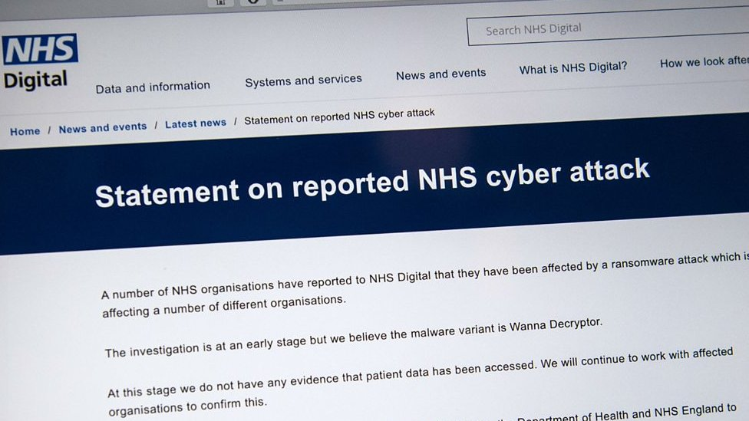
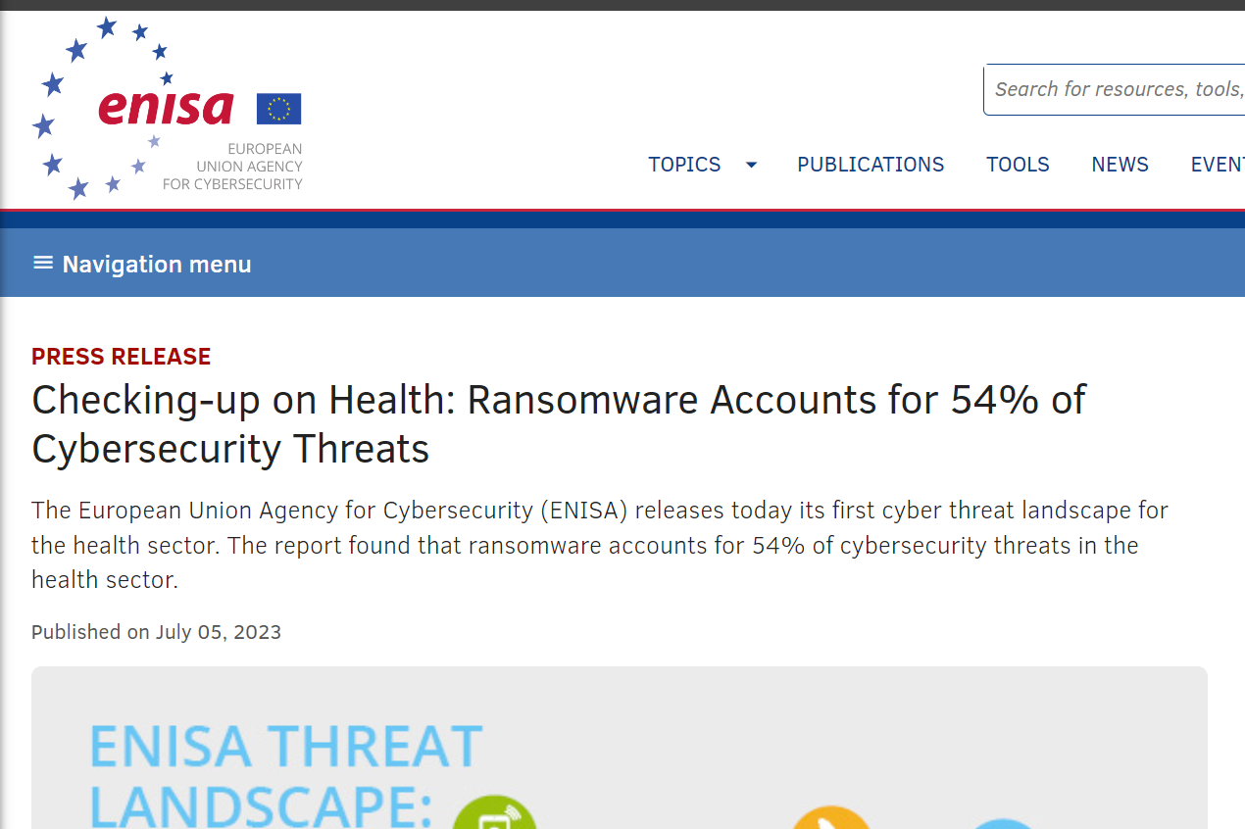
DNS for Governments
There are many under-protected public organizations (offices, hospitals, schools)
To fix the issue, governments around the world have started implementing Protective DNS on a countrywide level
UK, Australia, Canada have been running DNS country-wide services for public already for some time, built as turnkey projects
Rather than a turnkey project, DNS4EU will offer a ready-made product to be deployed (and/or customized) for any region/country
Notes:
Furthermore, another vertical is the one of the public sectore.
In the last years an emerging pattern can be identified all around the world.
We can all agree that public organizations are very very complex entities.
To make matters worse they still remain under-protected and are prone to large scale cyberattacks.
I guess we all remember the nightmare of WannaCry and the phishing messages related to COVID.
In several cases such as in the UK , Australia and Canada this has been addressed by introducing, country-wide protective DNS security solutions
To that regards DNS4EU will be offering a ready-made product that can support individual countries or even particular organizations in the countries for example particular ministries or agencies.

Slide 24
Notes:
A depiction of the proposed architecture could be seen in this diagram.
In practice, in each country we could support a combination of country-wide DNS resolvers, shared by all organizations,
or go even deeper and have individual protective dns infrastructure, dedicated to tenants.
This multi-tenant scenario will allow for flexibility in the deployments and complete separation of operational roles where necessary.

Slide 25
DNS for End Users
Public and distributed DNS resolvers managed by the consortium members
Multiple anycast IP addresses / hostnames for different flavours
Plain DNS
Protective DNS
Protective DNS + Adult content blocking
…
Support for IPv4/IPv6, DNSSec, DNS over TLS, DNS over HTTPS, (DNS over QUIC)
Notes:
Last but not least, of course we also plan to make available a service for end users.
The architecture behind this option would be utilizing the shared cloud infrastructure where multiple profiles would be made available to the users and they would be able to choose what would be more suitable for them.
For example we will have the pure DNS resolution option for anyone, whereas also offering the protective dns service with the DNS4EU threat intelligence
Or even a protective dns option combined with adult filtering which may operate as parental protection

Slide 26
DNS4EU/High level timeline
2023
2024
2025
2026+
Preparations and kick-offs
Telco and Government deployments
Attracting end-users
DNS4EU
post-project continuation
Technology, Security and standards compliance designs
Backend deployment
Research kick-offs
Attracting Telcos and Governments
Regional Threat Intelligence exchange setup
Legislation and Security requirements compliance achieved
Discoverability
Attracting end-users
Scaling the deployments as needed
Continuous improvements
Notes:
When it comes to the timeline of the project, here is a high level overview.
Let’s walk through the plan.
In 2023 we are aiming to finalize the technology and security design and kick off the implementation of the backend of the service.
We have already started discussing the options with Telcos and Goverments and we expect to do it even more intensively in the upcoming months.
Lastly we have kicked off the research activities and the first results look very promising
In the next year, we would like to invest our effort in the exchange of the regional threat intelligence by opening new channels or reusing existing ones.
When it comes to 2025 we would like to focus on the end users and start attracting them to the service while scaling our deployments by any means necessary.
In 2026 and beyond we expect to invest in the continuous improvement of the project

Slide 27
DNS4EU in a nutshell
The goal of DNS4EU is to provide EU citizens, companies, and institutions with a secure, privacy compliant, and powerful recursive DNS.
More Information Early Access & Stakeholder Group participation options available at whalebone.io/dns4eu
Notes:
In conclusion of the presentation and to summarize the key points: DNS4EU aims in the next years to provide a
resilient,
privacy-focused
protective DNS resolution service for all European citizens, companies and institutions
While
generating highly actionable threat intelligence.
Collaboration and community involvement are essential in order to be successful so we are very much looking forward to the discussion and answering any questions that you might have.
Thank you very much for your attention!

Slide 28
Thank you! Questions?
Let’s connect on LinkedIn
Andronikos Kyriakou
Tech Consulting Lead
andronikos.kyriakou@whalebone.io
Tomas Vogel
Threat Intelligence Analyst
tomas.vogel@whalebone.io

