Slide 1
SiERRA
Automating and scaling forensic investigations at Siemens CERT

Slide 2
Agenda

Slide 3
Intro Digital Forensics at CERT

Slide 4
About..
Siemens CERT
Corporate incident response team for all Siemens units
Globally distributed (DE, ES, MX, PT, RO, US)
Supports corporate security measures alongside other teams (Threat Intelligence, Detection, Red Teams, …)
More than 20 years of operation and research
/me
At Siemens CERT for ~6 years
Incident Responder
Forensics Analyst
Automation Engineer
Topic Lead for Forensics
Forensics at CERT
Small sub-team inside CERT
Supports the incident handling process with analysis, research, advice
Research, extend and develop in-house tooling to improve and accelerate incident response

Slide 5
Understanding attack details (what, when, how, who)
Incident Handling Process (simplified)
Detect
Respond
Remediate
Recover
Compromise of confidentiality, integrity and/or availability of information.
Analyze attack and initiate counter measures.
Contain: Limit extent of malicious activity
Mitigate: Prevent further damage
Repair: Fix & prevent reoccurring
Restore integrity of affected systems to a non-degraded operational state.
Forensic Analysis Stages
Information Gathering
Data Preparation
Data Analysis
Reporting

Slide 6
Yesterday
Attack Analysis & Forensics (simplified steps)
Data Acquisition
Identify and acquire raw data as potential evidential data.
Data Preparation
Identify and process steps required for data preparation.
Data Analysis
Understanding attack capabilities.
Analysis Report
Prepare report & recommend counter measures
Yesterday: Manual orchestration of case specific tools.
Available “Toolbox”
3.4
3.1
2.2
4.1
1.1
1.3
3.3
2.1
4.2
1.2
3.2
3.5

Slide 7
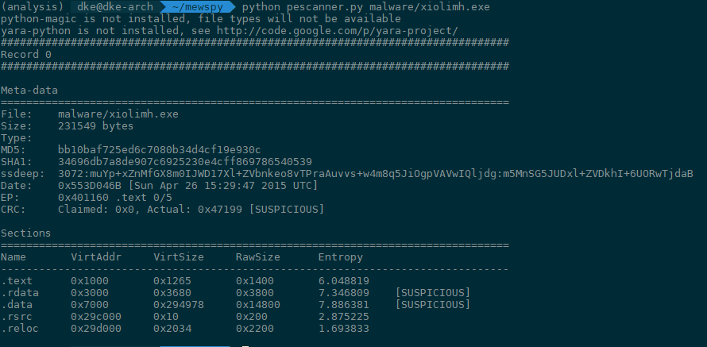
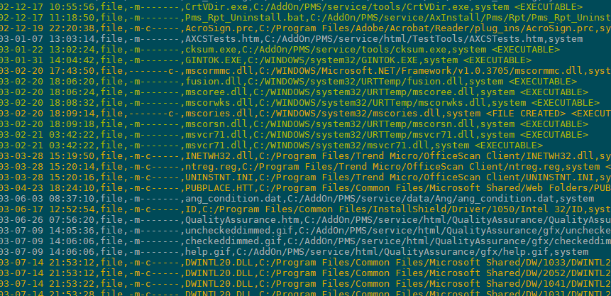
Yesterday
Attack Analysis & Forensics (simplified steps)
Data Acquisition
Identify and acquire raw data as potential evidential data.
Data Preparation
Identify and process steps required for data preparation.
Data Analysis
Understanding attack capabilities.
Analysis Report
Prepare report & recommend counter measures
Available “Toolbox”
2.2
4.1
2.1
4.2

Slide 8
Yesterday: The problem
Consistency ?
Scalability ?

Slide 9
Forensics today: The plan
Attack Analysis & Forensics (simplified steps)
Data Acquisition
Identify and acquire raw data as potential evidential data.
Data Preparation
Identify and process steps required for data preparation.
Data Analysis
Understanding attack capabilities.
Analysis Report
Prepare report & recommend counter measures
Automated deployment of all applicable tools.
2.1
3.1
3.5
4.1
1.1
2.3
3.3
3.7
4.3
1.3
2.2
3.2
3.6
4.2
1.2
2.4
3.4
3.8

Slide 10
SiERRA Architecture Overview

Slide 11
Forensics automation: Building blocks
Automation Backend / Infrastructure
User Interface
Common Tool Interface

Slide 12
Forensics automation: Building blocks
Siemens Extensible Rapid Response Automator
Automation Backend / Infrastructure
User Interface
Common Tool Interface
SiERRA

Slide 13
SiERRA: Architecture and Nomenclature
Case
Encapsulates everything needed for the investigation
Worker
Analysis tools that report to a central job broker and advertise their abilities and requirements (Vacancies)
Evidence
Files and pieces of information, imported or generated by tools
Evidence forms a tree-like hierarchy based on origin
Job
A request for a certain worker to start processing in a case with defined input parameters. Also tracks job status.
$MFT
File details
Image.dd
SAM
Users.csv
Finding
Relevant bits of information from the case evidence, enriched with explanatory text

Slide 14
SiERRA: Tech Stack
User Interface
Web Interface
API Layer
Case API
Evidence API
Job API
Workers
1.1
2.1
3.1
3.5
4.1
1.3
2.3
3.3
3.7
4.3
1.2
2.2
3.2
3.6
4.2
2.4
3.4
3.8
Data
File Storage
Database

Slide 15
Workers The common tool interface

Slide 16
Common Tool Interface: The Worker abstraction

Slide 17
Common Tool Interface: The Worker abstraction
Run analysis over input data
Wrap tool in a script
Define worker properties
Define worker input validation
Ready-to-use python library (“worker-lib”)
Backend communication
File handling abstractions
Job management
Store results in case folder
Alert about suspicious findings
Write results into a database
Report progress and job status

Slide 18
Common Tool Interface: The Worker abstraction
{ "title": "sam",
"friendly_name": "SAM, SECURITY and ntds.dit) parser",
"properties": {
"sam_hive": {
"title": "SAM Hive",
"evidence_type": "fileEvidence",
"evidence_filters": [
"(?i)[/_-]sam$"
],
},
[…]
"extra_passwords": {
"type": "string",
"description": "Additional
passwords to try",
},
"brute_force": {
"type": "boolean",
"default": false,
}
},
"required": [ "sam_hive" ]
}
Wrap tool in a script
Define worker properties
Define worker input validation
Ready-to-use python library (“worker-lib”)
Backend communication
File handling abstractions
Job management
Library registers worker at the backend using JSON schema description

Slide 19
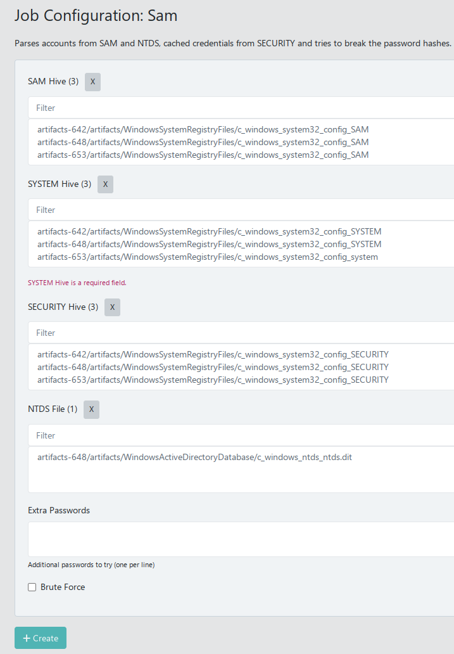
Common Tool Interface: The Worker abstraction
Wrap tool in a script
Define worker properties
Define worker input validation
Ready-to-use python library (“worker-lib”)
Backend communication
File handling abstractions
Job management

Slide 20
Workflows Orchestrate processing

Slide 21
Workflows
Workers are nice, but processing evidence still needs lots of clicking ☹
We want to define comprehensive processing jobs that make use of all our workers: Workflows
Disk Image
Hash Contents
Check IoCs
Run yara
Extract artifacts
Parse artifacts
Check IoCs

Slide 22
Workflows
Workflow parameters (%)
name: Eventlogs from Image
job_name: wf-image_eventlogs
parameters:
- name: evidence
type: multiDiskImageEvidence
- name: keyfile
type: fileEvidence(csv, txt)
optional: true
extract_artifacts:
job: artifacts
parameters:
evidence: "%evidence"
artifact: SiemensArtifactsAll
keyfile: "%keyfile"
parse_eventlogs:
job: eventlogs
parameters:
logs: "$extract_artifacts"
Execution order and parallelism determined by dependencies
artifacts
eventlogs
Use another stage's output as parameter ($)

Slide 23
Workflows
parse_eventlogs:
job: eventlogs
parameters:
logs: "$extract"
artifacts
Recipe
…
EventLogs/c_windows_system32_winevt_logs_Application.evtx
LogFiles/c_temp_system
MFTMetaFiles/c_$MFT
RegistryHives/c_windows_system32_config_SAM
RegistryHives/c_windows_system32_config_System
…
sam
eventlogs

Slide 24
Workflows
parse_eventlogs:
job: eventlogs
parameters:
logs: "$extract"
artifacts
Recipe
…
EventLogs/c_windows_system32_winevt_logs_Application.evtx
LogFiles/c_temp_system
MFTMetaFiles/c_$MFT
RegistryHives/c_windows_system32_config_SAM
RegistryHives/c_windows_system32_config_System
…
sam
eventlogs

Slide 25
Workflows
parse_eventlogs:
job: eventlogs
parameters:
logs: "$extract"
artifacts
Recipe
{
"title": "eventlogs",
"friendly_name": "EVT(X) parser",
"category": "reporting",
"properties": {
"logs": {
"evidence_type": "anyEvidence",
"evidence_filters": [
"(?i)\\.(evt|evtx|xml)$"
],
}
},
"required": [ "logs" ]
}
…
EventLogs/c_windows_system32_winevt_logs_Application.evtx
LogFiles/c_temp_system
MFTMetaFiles/c_$MFT
RegistryHives/c_windows_system32_config_SAM
RegistryHives/c_windows_system32_config_System
…
sam
eventlogs
Worker vacancy
We use the same process for the second job that also consumes this output, running them in parallel.

Slide 26
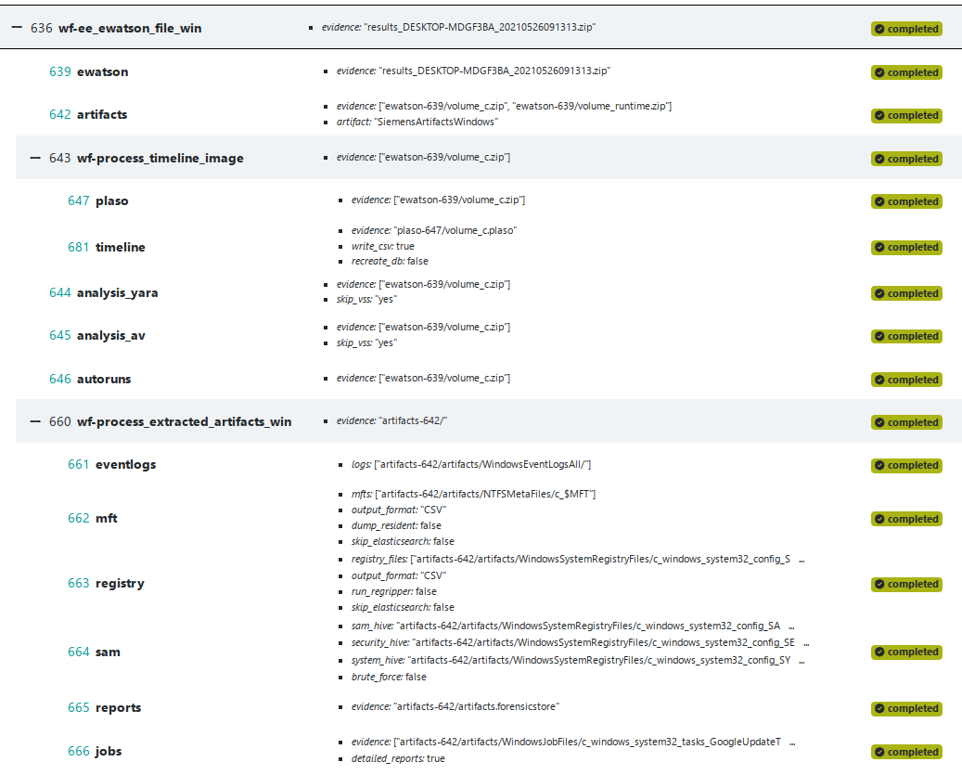
Workflows

Slide 27
User Interface Alert, Analyze, Document

Slide 28
User Interface: Philosophy
Data centric
Different types of data need different views
Timelines
Trees
Tables
Markdown
Plain Text
Ability to filter and search
Documentation
Seamless way to document findings while investigating
"Document what you see"
Convention over configuration
Worker output that contains ".result." in its name will be displayed for the asset it belongs to
".report." is treated as an alert and displayed prominently
View type determined by file extension

Slide 29
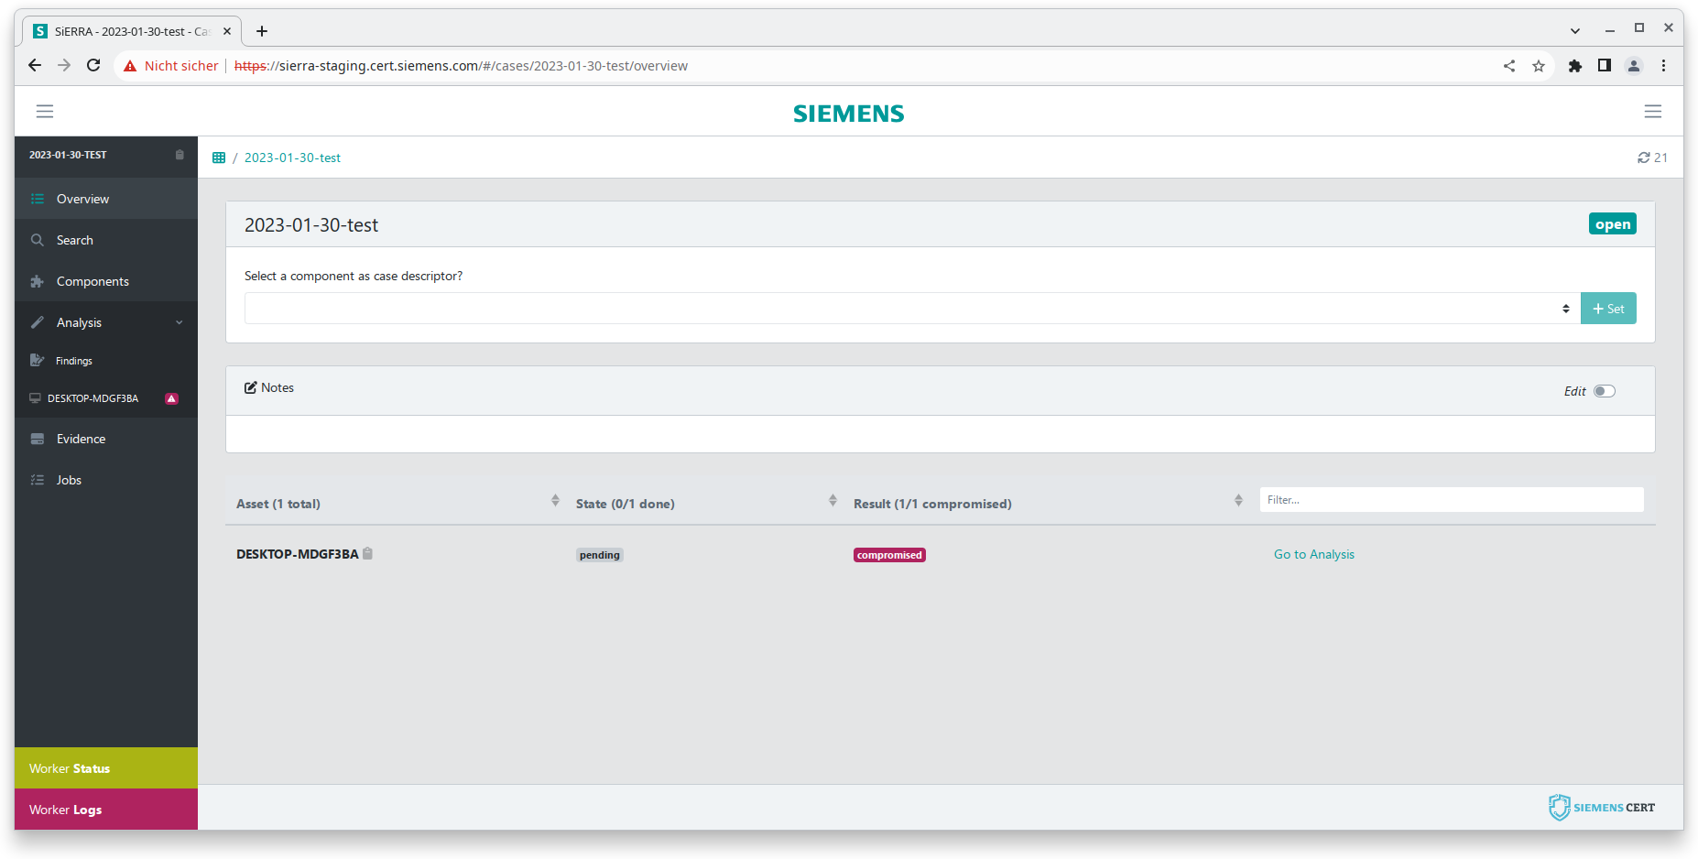
User Interface: Impressions

Slide 30
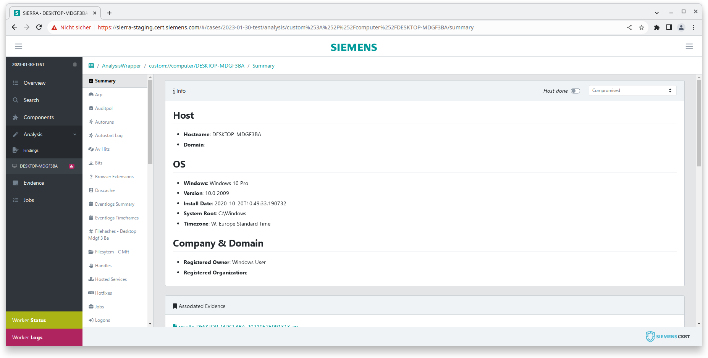
User Interface: Impressions

Slide 31
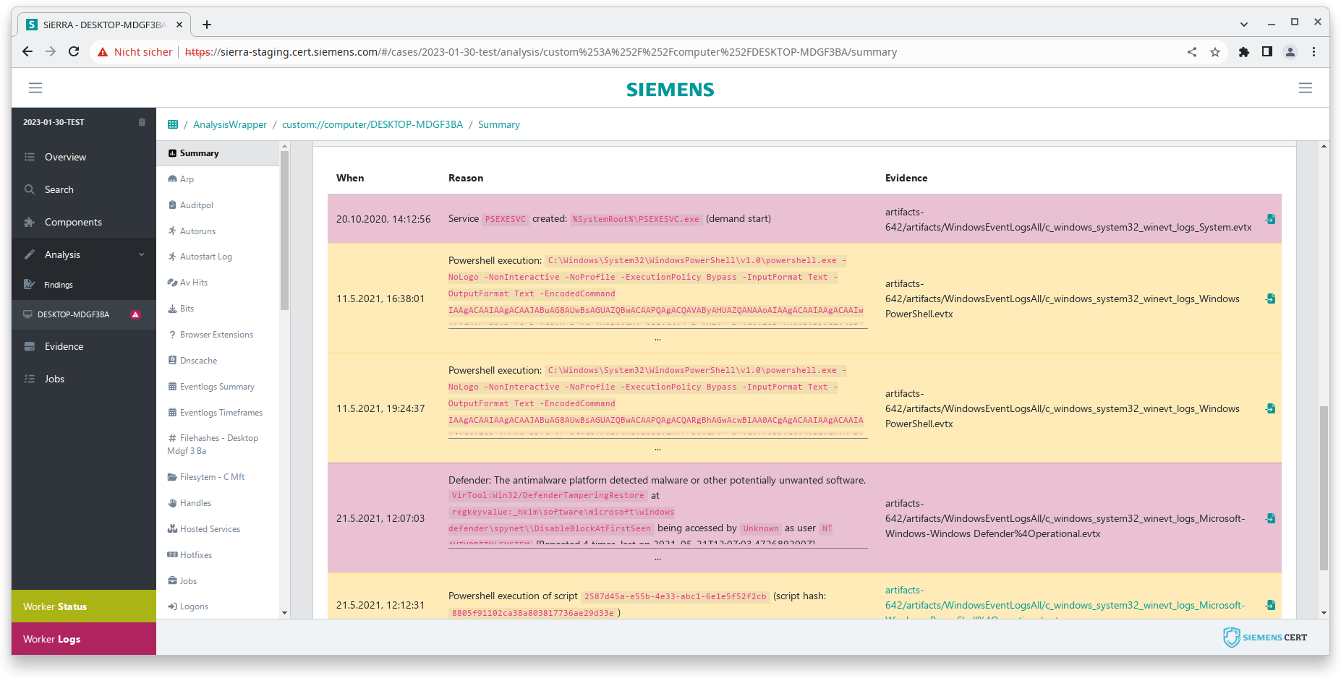
User Interface: Impressions

Slide 32
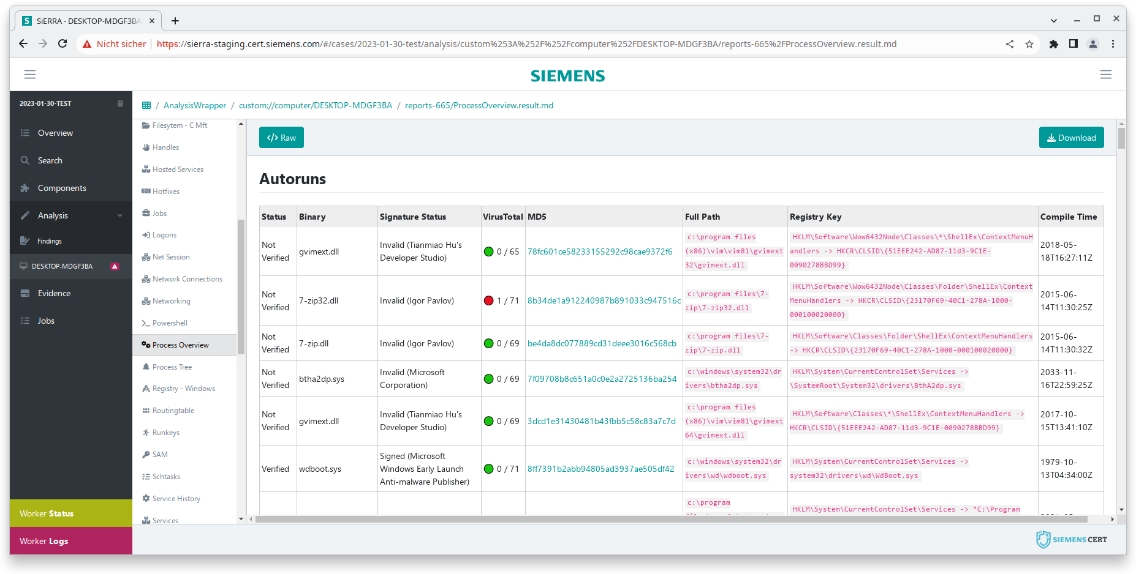
User Interface: Impressions

Slide 33
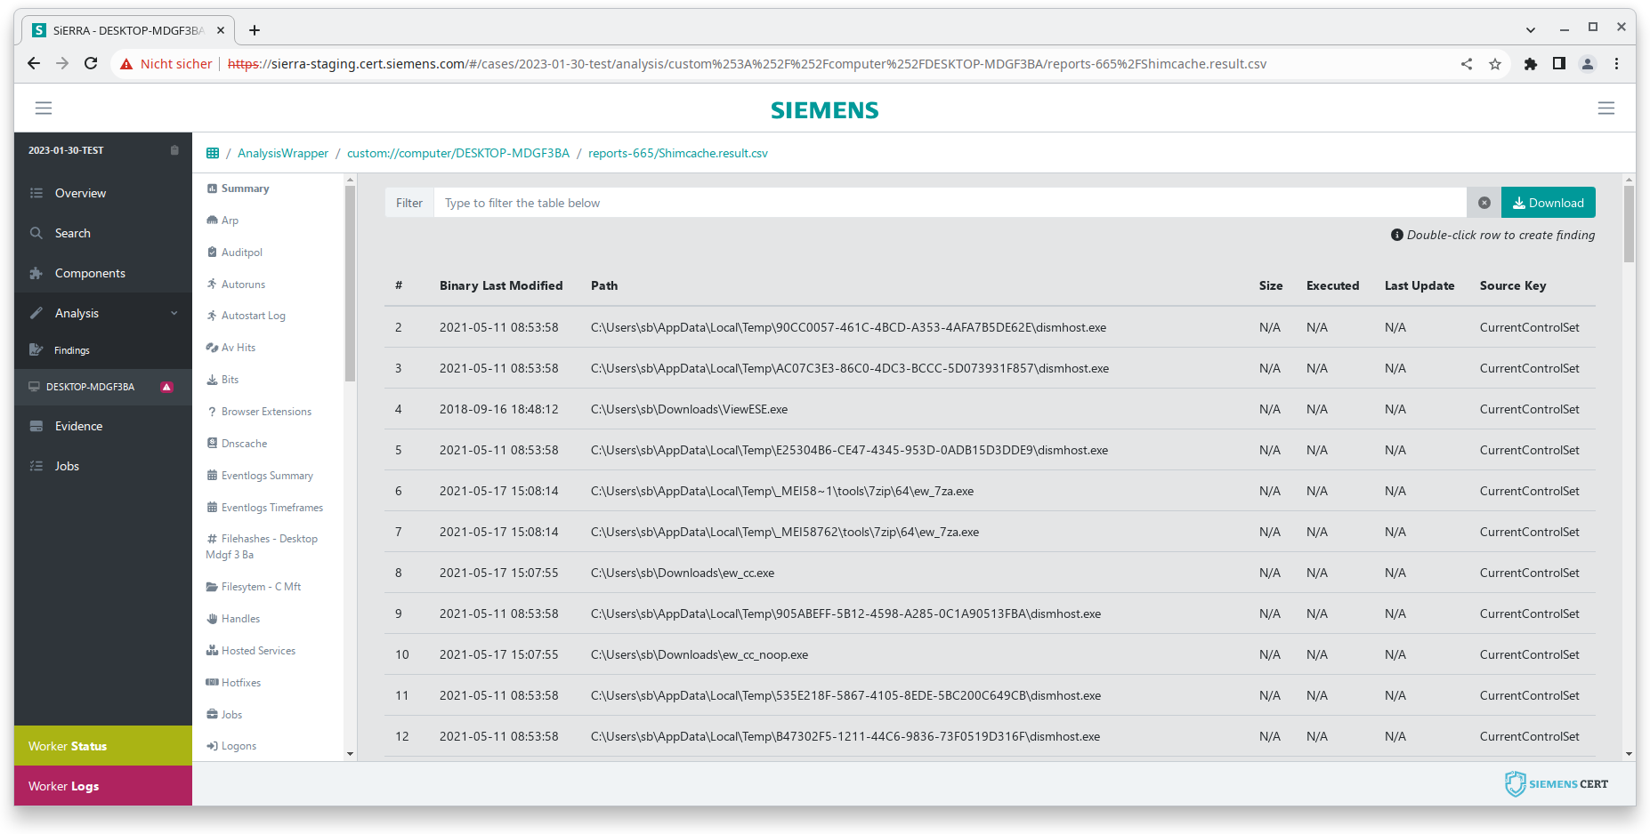
User Interface: Impressions

Slide 34
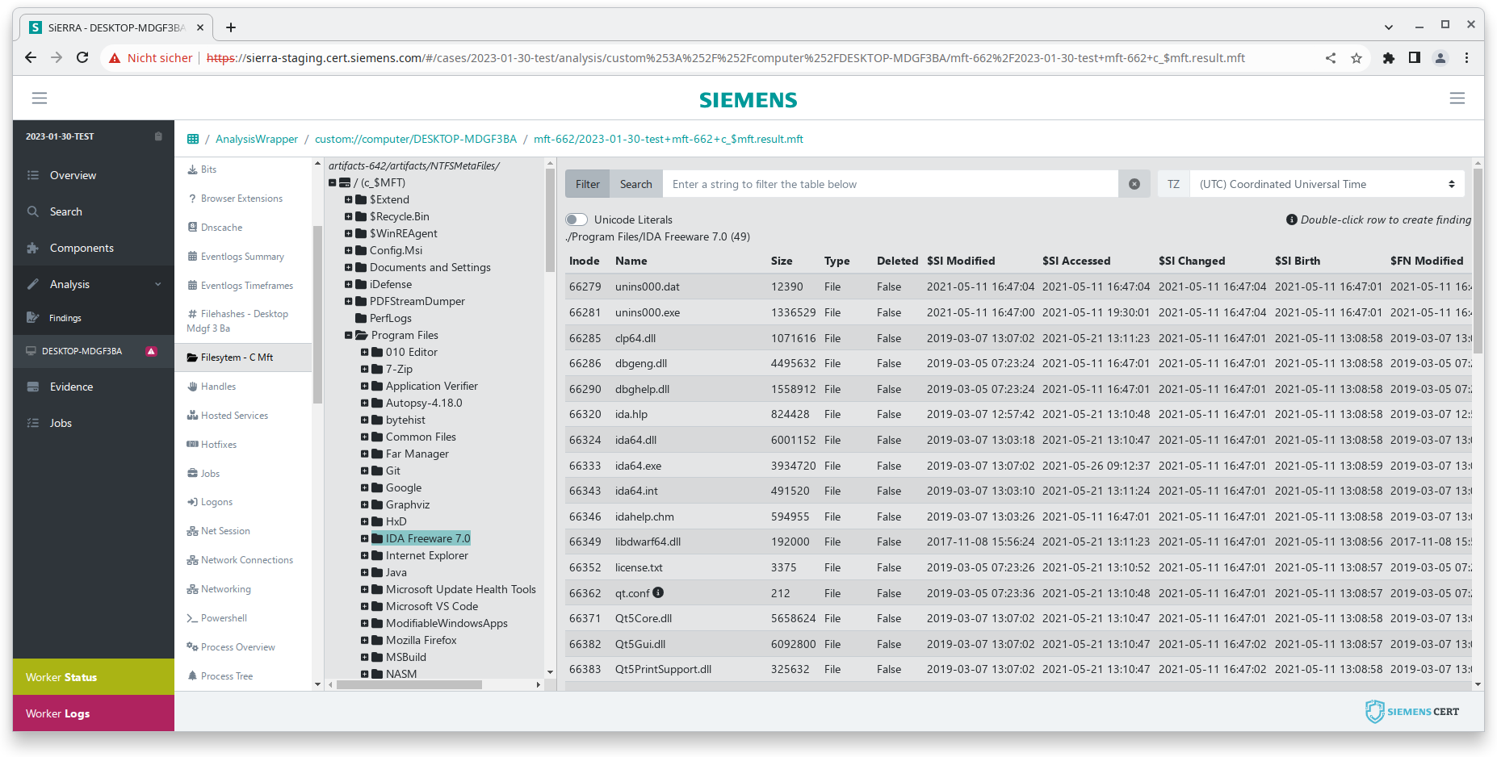
User Interface: Impressions

Slide 35
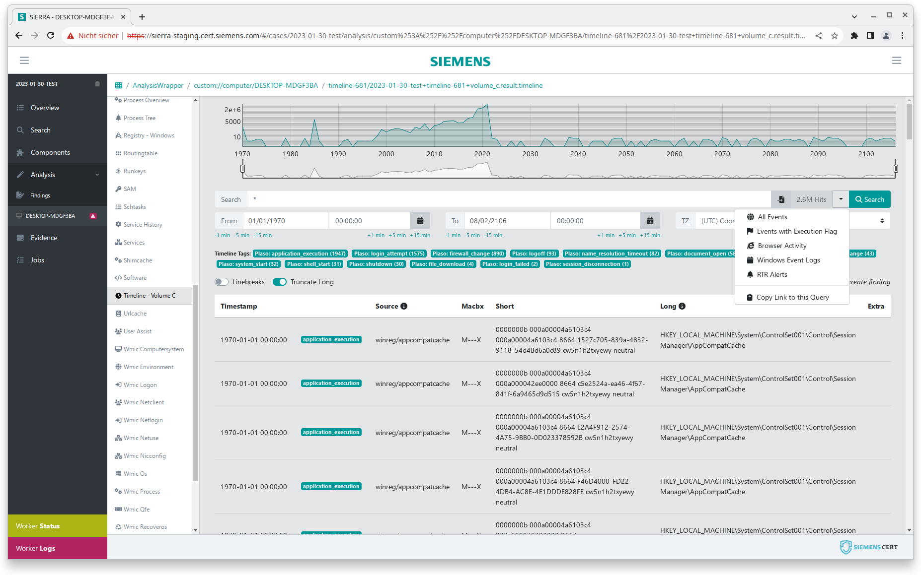
User Interface: Impressions

Slide 36
User Interface: Impressions
One-click filtering for plaso and Sigma tags

Slide 37
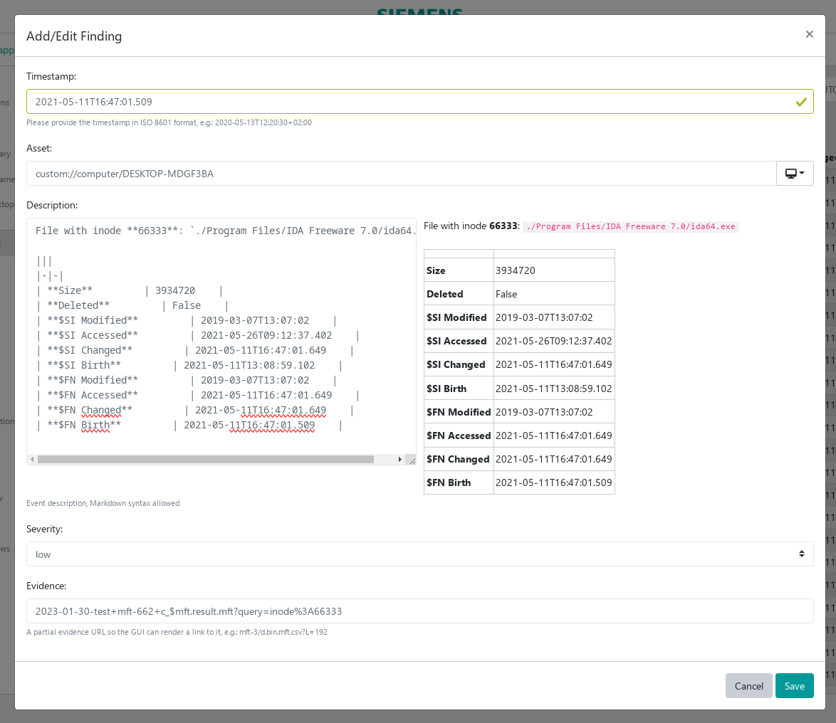
User Interface: Impressions

Slide 38
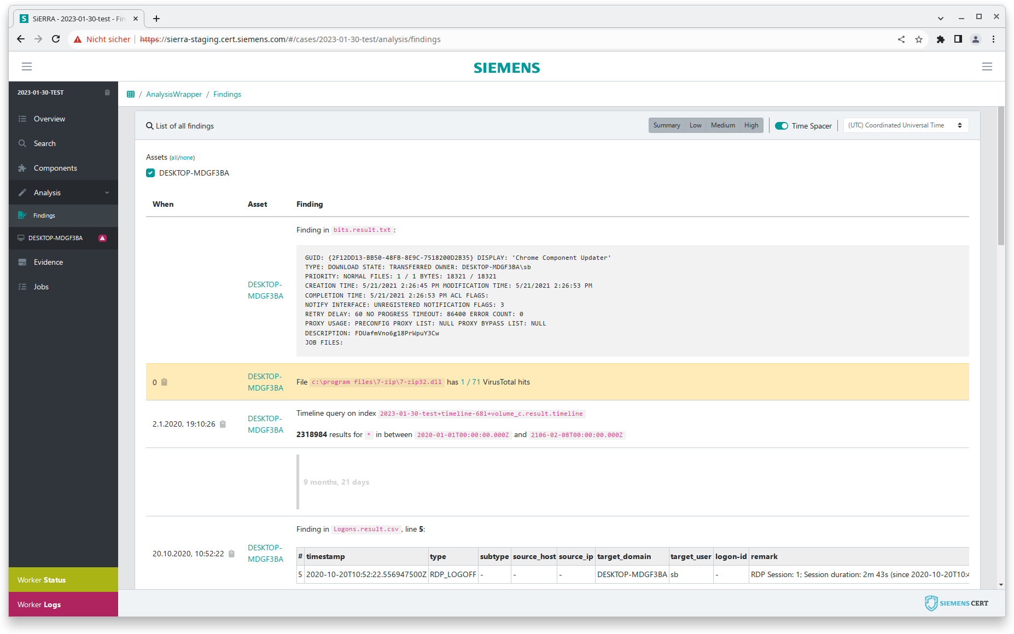
User Interface: Impressions

Slide 39
Summary

Slide 40
Summary
Quality
Consistency in data processing and storage
Low-effort documentation
Improved collaboration
Flexibility
Workers are easily written
Adaptable workflows
Versatile viewers
Exportable (file-first approach)
Scalability
Online, Offline, On Prem, Cloud, On-the-go
Easily scalable

Slide 41
Acknowledgements
Open Source DFIR authors!
log2timeline/plaso Team
Joachmin Metz (libyal)
SigmaHQ Team
... and so many more
CERT Forensics alumni
Stefan Berger
Jonas Plum

Slide 42
Questions?
Demian Kellermann
CYS DEF CERT DF
E-mail demian.kellermann@siemens.com
E-mail cert@siemens.com
Web https://siemens.com/cert

Slide 43
Workflows
job_name: wf-ee_image_full
extract:
job: artifacts
parameters:
evidence: "%evidence"
artifact: SiemensArtifactsAll
keyfile: "%keyfile"
parse_eventlogs:
job: eventlogs
parameters:
logs: "$extract"
process_sam:
job: sam
parameters:
sam_hive: "$extract /(?i)(config_|/)SAM$/"
security_hive: "$extract /(?i)(config_|/)SECURITY$/"
system_hive: "$extract /(?i)(config_|/)SYSTEM$/"
ntds_dit: "$extract "
brute_force: false
{
"title": "wf-ee_image_full",
"case": "2023-10-15-demo",
"parameter": {
"evidence": "drive_c.dd"
}
}
Job description
artifacts
sam
eventlogs
Workflow

Slide 44
Workflows
job_name: wf-ee_image_full
extract:
job: artifacts
parameters:
evidence: "%evidence"
artifact: SiemensArtifactsAll
keyfile: "%keyfile"
parse_eventlogs:
job: eventlogs
parameters:
logs: "$extract"
process_sam:
job: sam
parameters:
sam_hive: "$extract /(?i)(config_|/)SAM$/"
security_hive: "$extract /(?i)(config_|/)SECURITY$/"
system_hive: "$extract /(?i)(config_|/)SYSTEM$/"
ntds_dit: "$extract "
brute_force: false
{
"title": "wf-ee_image_full",
"case": "2023-10-15-demo",
"parameter": {
"evidence": "drive_c.dd“
}
}
Job description
Run this one first, it has no dependencies on other workers
artifacts
sam
eventlogs
Workflow

Slide 45
Workflows
job_name: wf-ee_image_full
extract:
job: artifacts
parameters:
evidence: "%evidence"
artifact: SiemensArtifactsAll
keyfile: "%keyfile"
parse_eventlogs:
job: eventlogs
parameters:
logs: "$extract"
process_sam:
job: sam
parameters:
sam_hive: "$extract /(?i)(config_|/)SAM$/"
security_hive: "$extract /(?i)(config_|/)SECURITY$/"
system_hive: "$extract /(?i)(config_|/)SYSTEM$/"
ntds_dit: "$extract "
brute_force: false
{
"title": "artifacts",
"id": 42,
"case": "2023-10-15-demo",
"parameter": {
"evidence": "drive_c.dd",
"artifact": "SiemensArtifactsAll",
}
}
New job
artifacts
sam
eventlogs
Workflow

Slide 46
Workflows
parse_eventlogs:
job: eventlogs
parameters:
logs: "$extract"
…
EventLogs/c_windows_system32_winevt_logs_Application.evtx
LogFiles/c_temp_system
MFTMetaFiles/c_$MFT
RegistryHives/c_windows_system32_config_SAM
RegistryHives/c_windows_system32_config_System
…
Recipe
Filtering just leaves the EVTX file
Prepend the last worker's output directory and the job is ready
{
"title": "eventlogs",
"friendly_name": "EVT(X) parser",
"category": "reporting",
"properties": {
"logs": {
"evidence_type": "anyEvidence",
"evidence_filters": [
"(?i)\\.(evt|evtx|xml)$"
],
}
},
"required": [ "logs" ]
}
{
"title": "eventlogs",
"case": "2023-10-15-demo",
"parameter": {
"logs": [
"artifacts-42/EventLogs/c_windows_system32_
winevt_logs_Application.evtx"
],
}
}
New job
Worker vacancy
We use the same process for the second job that also consumes this output, running them in parallel.

Slide 47
Summary
Consistency
Consistency in data processing and storage
Well defined workflows that can be adapted over time
Re-running yields the same (or more) results
Documentation made easy
Every table row, every piece of text, every timeline entry can be marked as important
Free text storytelling with Markdown formatting
Extensibility
Workers are easily written and there is usually no need to touch anything else
Scalability
System allows for parallel processing
Scales with hardware
Independence
System is environment independent
Offline/Online/Cloud/On-prem/Portable
Exportability
File-first approach. Essentially, every result is a file

Slide 48
Results
Fun for the whole IR team
Incident handlers can start processing data as soon as it comes in
Automatic findings and common interface lower the barrier to entry into forensics
Improved collaboration due to easy access
Improved Documentation
Low-effort documentation using pre-filled forms
Accessible findings summary
Quick reaction speed
Workers are easily adapted or added for new threats and immediately become part of every investigation
Low barrier to entry due to dockerized approach and worker-library support

