Slide 1
SOC Analyst’s Arsenal
Essential Tools, Tips and Tricks for Effective Investigations
Notes:
Welcome everyone, today I will be talking about SOC things, specifically tools used by analysts in a SOC.
Goal of this talk is to give you atleast one idea on how to make your investigations more efficient or faster. Lets begin

Slide 2
Whoami
  Samuel Kavaler
  SOC Team Manager @ Ontinue
  6 years of experience in Cyber Security
  primary focus on SOC processes and people

Slide 3
Agenda
  OPSEC
  REPUTATION ENGINES
  TOOLS
  AUTOMATION
  OSINT
  LOG TRANSFORMATION
  EDUCATION

Slide 4
Opsec
  Analysts need to be trained on OPSEC
  Uploading files into public engines – a big no-no
  Make sure links don’t contain user emails (base64)
  Provide guidance to your your Service Desk
  MSSP - clean templates, note taking
  Consider separate unfiltered / anonymous internet access
Notes:
Analysts needs to be trained on OPSEC
If you are uploading suspicious links to VT - make sure these does not contain users email addresses as attackers sometime prefill the user field (can be in encoded in base64)
Uploading files into public engines is a big no-no – you don’t want to tip off the threat actors by uploading their new malware to VT, because if you are targeted, they will be watching
Next, I would recommend chatting with your Service Desk Management and ask if your users send them suspicious files, if that is the case provide guidance to your SD on the process
If you are MSSP and serve multiple customers – create training for your new joiners on how to use clean templates for customer communication, note taking, not everyone is well organized and you want to make sure there is no cross customer information sharing
Last point, consider dedicated external internet connection that doesn’t have an IP associated with your organization. This can be useful for sensitive investigations or when analysts want to download exploit files for analysis and testing.

Slide 5
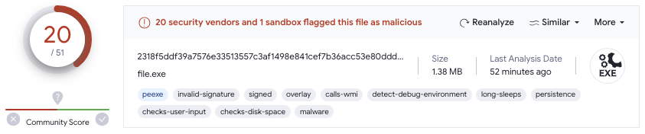
virustotal
Notes:
Everyone knows VirusTotal, but in my experience not everyone is aware about some features so let me highlight some of the functionalities starting with file hash lookups
Not just score, file size can sometimes tell you more and more important always check Last Analysis date, Reanalyse

Slide 6
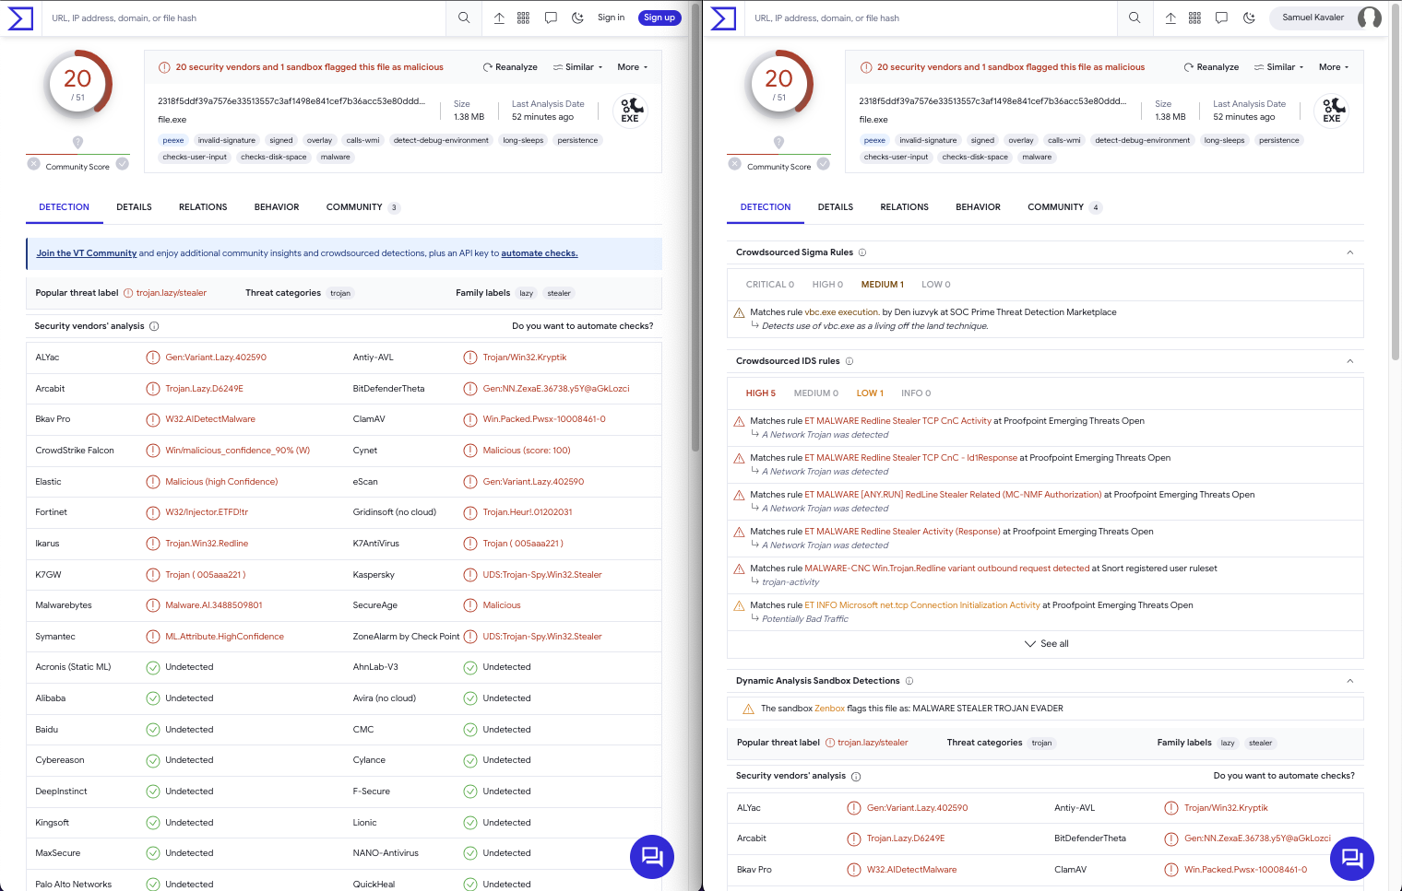
Notes:
Starting with the main view, the Detection tab
This is the same file open in two tabs, but on the right side I am signed in with a free account.
If you sign in, you get all the extra detection information like Sigma rules, IDS rules and Sandbox results details

Slide 7
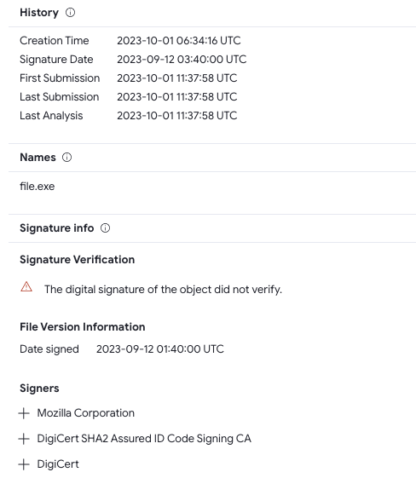
  Details tab
  History (dates)
  Names
  Signature info
Notes:
History – one of the most important information is First submission which tells us what is the minimal age of the file, this can sometimes give great context to your investigation. Don’t rely on Creation Time can be spoofed.
Threat actors like to rename tools and the Names section can provide useful information if the file you are interested in was renamed.
Is the file signed and who are the Signers

Slide 8
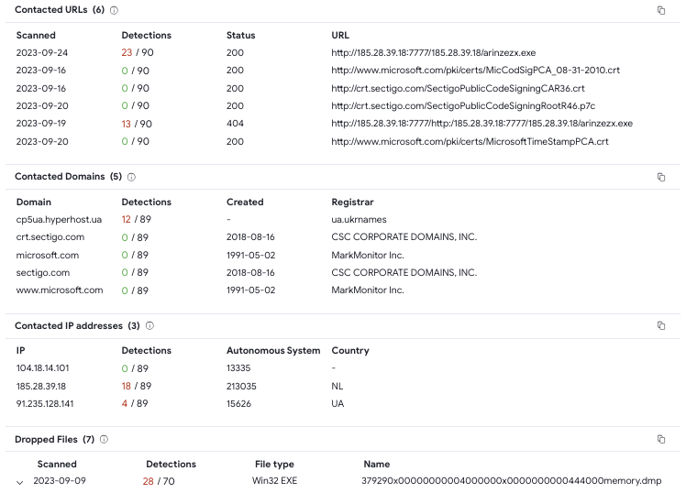
  Relations tab
  Contacted URLs
  Contacted Domains
  Contacted IP addresses
  Dropped Files
Notes:
Relation tab provides access to potential IOCs - Contacted URLs, Domains and IP addresses

Slide 9
Notes:
Also dropped files can provide information, for example ransomware notes
Please note the Copy icons on the right side of the screenshots

Slide 10
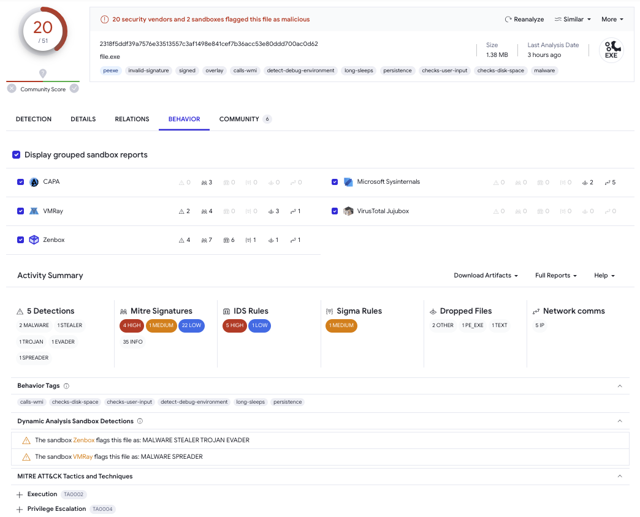
Notes:
Behavior tab with the sandbox reports if you want to dig deeper, sometimes the reports contain screenshots

Slide 11
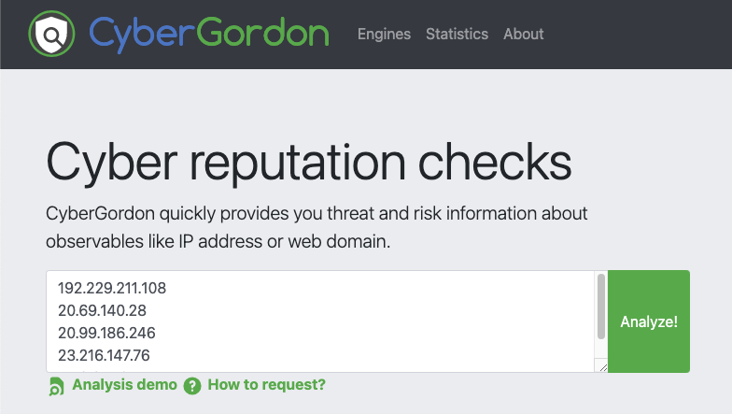
CYBERGORDON
  Observables
  IP
  FQDN
  URL
  Hashes
  Email
Notes:
Cybergordon is personal project by Marc-Henry Geay, where you upload up to 10 observables at once and it will check if there are any existing records

Slide 12
IP LOOKUPS
  AbuseIPDB
  Shodan
  GreyNoise
Notes:
Besides Virustotal, Shodan for open ports / services

Slide 13
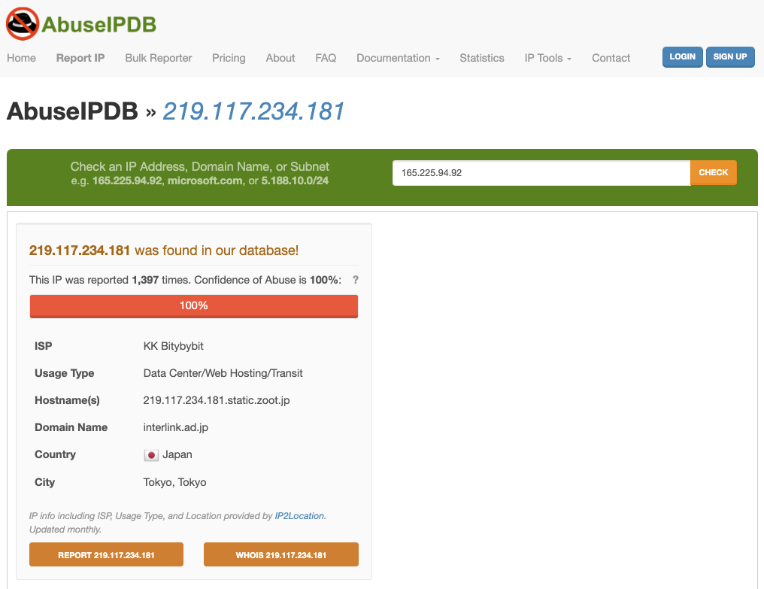
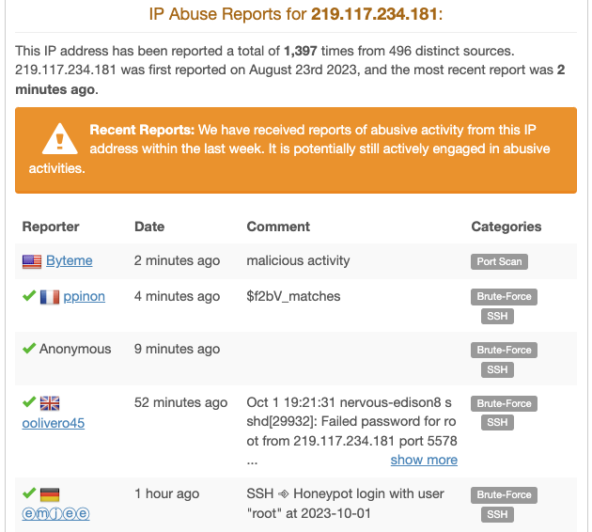

Slide 14
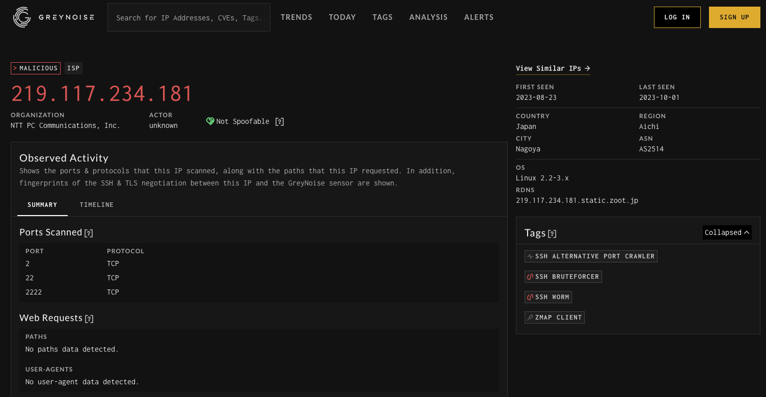
Notes:
Greynoise will give you warnings like this IP is opportunistically scanning for XYZ vulnerability

Slide 15
URL LOOKUPS
  urlscan.io
  browserling.com
  app.any.run

Slide 16
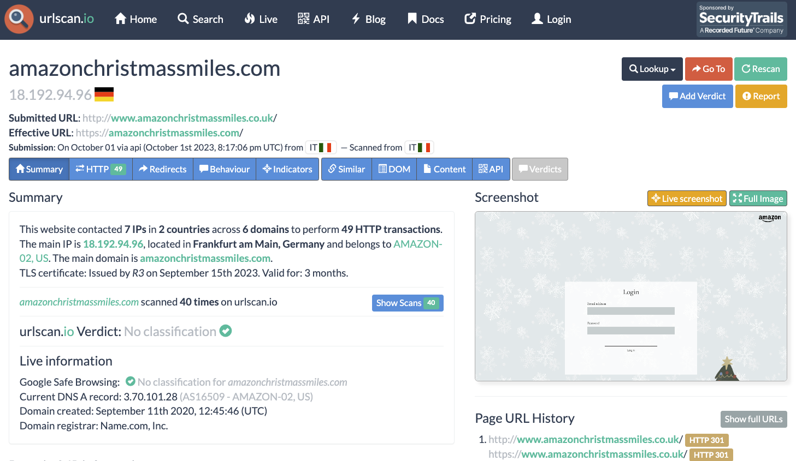

Slide 17
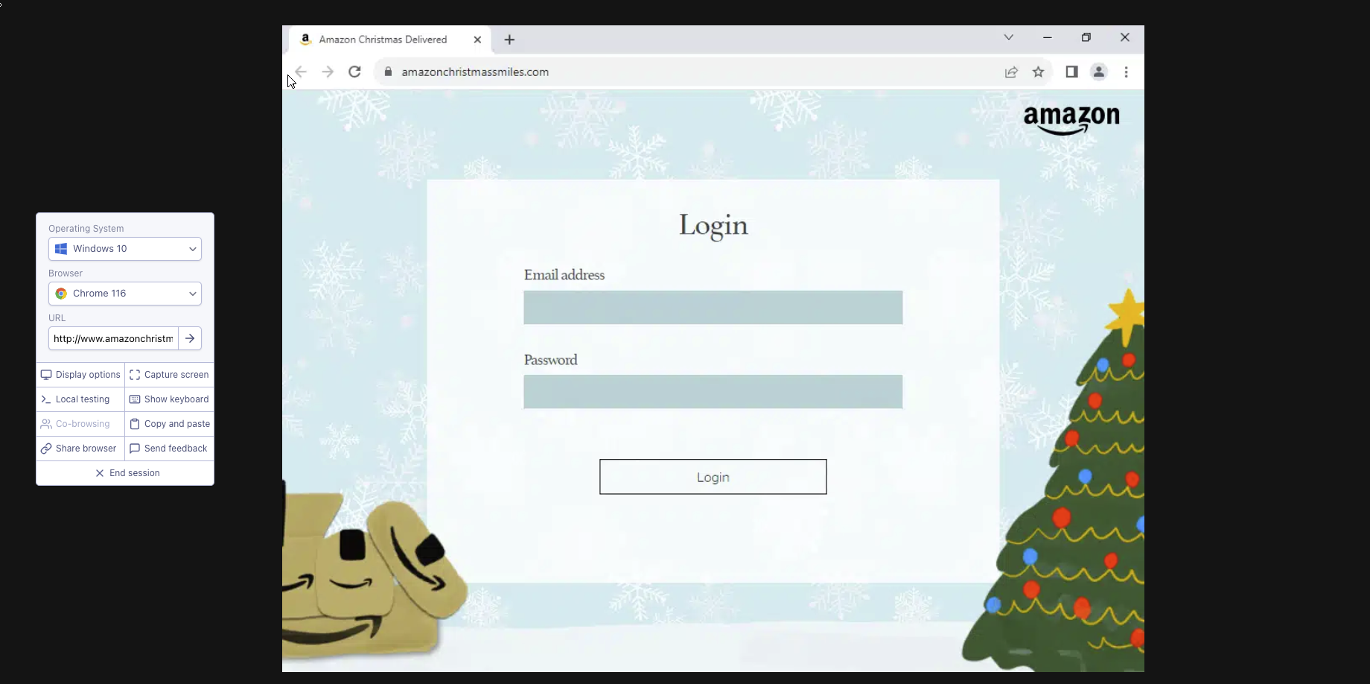

Slide 18
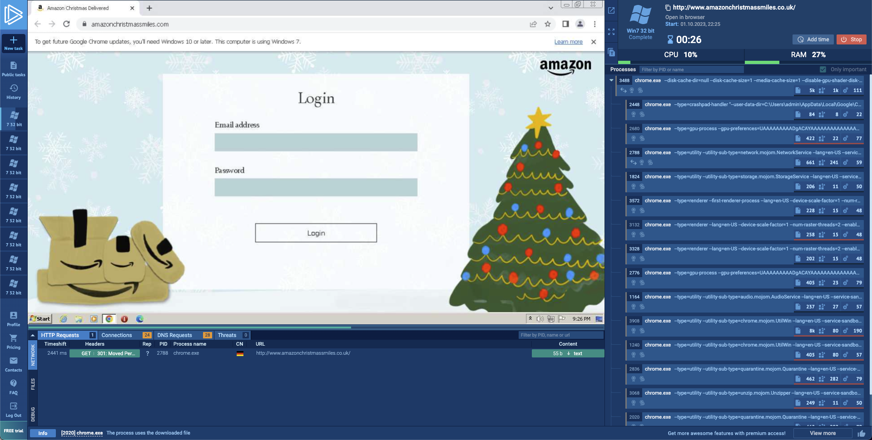

Slide 19
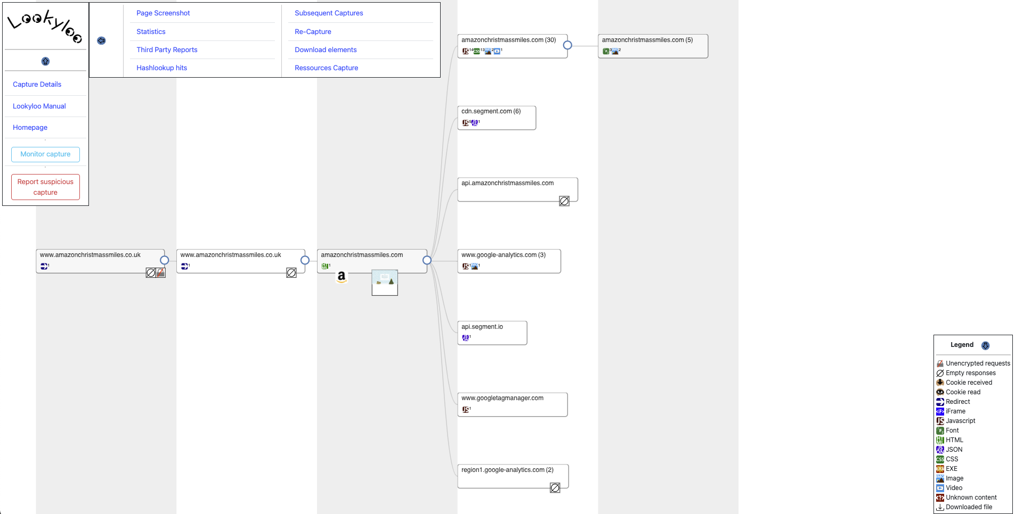
  lookyloo.circl.lu
Notes:
Lookyloo is a web interface that captures a webpage and then displays a tree of the domains, that call each other.
lookyloo.circl.lu

Slide 20
EMAIL HEADER ANALYSIS
  mxtoolbox.com
  mha.azurewebsites.net

Slide 21
PCAP Analysis
  Wireshark
  Customize your profile and Columns
    Brad Duncan
    https://www.malware-traffic-analysis.net/tutorials/index.html
    Chris Greer
    https://www.youtube.com/@ChrisGreer

Slide 22

EVTX Analysis
  Chainsaw
  Search through event logs using string matching and regex patterns
  Hunt for threats using Sigma detection rules
  Shimcache analysis
Notes:
Windows event logs
Also Shimca

Slide 23
Automation?
  How to be more efficient and make your life easier?

Slide 24

Autohotkey
  Open source scripting language for Windows that can save your time, keystrokes and mouseclicks by making customized shortcuts and scripts.
  Hotstrings
  Hotkeys
Notes:
Open source scripting language for Windows that can save your time, keystrokes and mouseclicks by making customized shortcuts and scripts.

Slide 25
  Hotstrings
  Used to expand abbreviations as you type them (auto-replace)
::btw::by the way
::#@::mylongemail@protonmail.com
::#ho::Hornických učňů 123
::#fpu::False Positive - confirmed with the user
Notes:
Hotstrings are used to expand abbreviations as you type them (auto-replace)
Great if you need to use some kind of template, don’t need to copy paste every time

Slide 26
  Hotstrings
::#tt::
(
Description
Entities
Analysis
Verdict
)

Slide 27
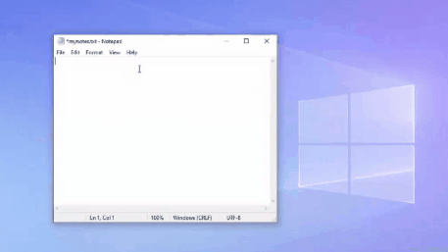
  Hotstrings

Slide 28
  Hotkeys
  Can trigger action such as launching a program or keyboard macro
+n::Run, mynotes.txt
^h::
{
Send, ^c
Sleep 10
Run, https://www.virustotal.com/gui/file/%clipboard%
Return
}
^ == Ctrl
+ == Shift
! == Alt
Notes:
Hotkeys can trigger action such as running a program, opening a file or keyboard macro
Open notes, open hash in Virustotal

Slide 29
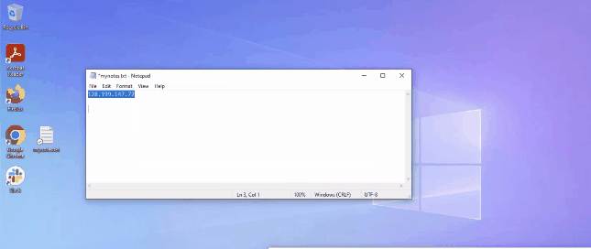
  Hotkeys
Notes:
IP address search

Slide 30
  Hotkeys (ahk v1)
^g::
{
Send, ^c
Sleep 10
Run, https://www.virustotal.com/gui/ip-address/%clipboard%
Run, https://www.abuseipdb.com/check/%clipboard%
Run, https://otx.alienvault.com/indicator/ip/%clipboard%
Run, https://viz.greynoise.io/query/?gnql=%clipboard%
Run, https://talosintelligence.com/reputation_center/lookup?search=%clipboard%
Return
}
^ == Ctrl
+ == Shift
! == Alt
Notes:
IP address search

Slide 31
  Hotkeys (ahk v2)
^g::
{
A_Clipboard := ""
Send "^c"
ClipWait
Run "https://www.virustotal.com/gui/ip-address/" A_Clipboard
Run "https://abuseipdb.com/check/" A_Clipboard
Run "https://otx.alienvault.com/indicator/ip/" A_Clipboard
Run "https://viz.greynoise.io/query/?gnql=" A_Clipboard
Run "https://talosintelligence.com/reputation_center/lookup?search=" A_Clipboard
}
^ == Ctrl
+ == Shift
! == Alt
Notes:
IP address search

Slide 32
Powertoys run
  Quick launcher for Windows power users
  https://learn.microsoft.com/en-us/windows/powertoys/run
  Quick Lookup Plugin by Mitchell Smith
  https://github.com/GTGalaxi/quick-lookup-ptrun
Notes:
PowerToys Run is a quick launcher for windows power users. Main fuctionalities are searching, command execution, and lot more. It also supports custom pluggins and there is one from Mitchel Smith that does similar thing to what I showed with Autohotkey. You can also make something similar easily with Python,

Slide 33
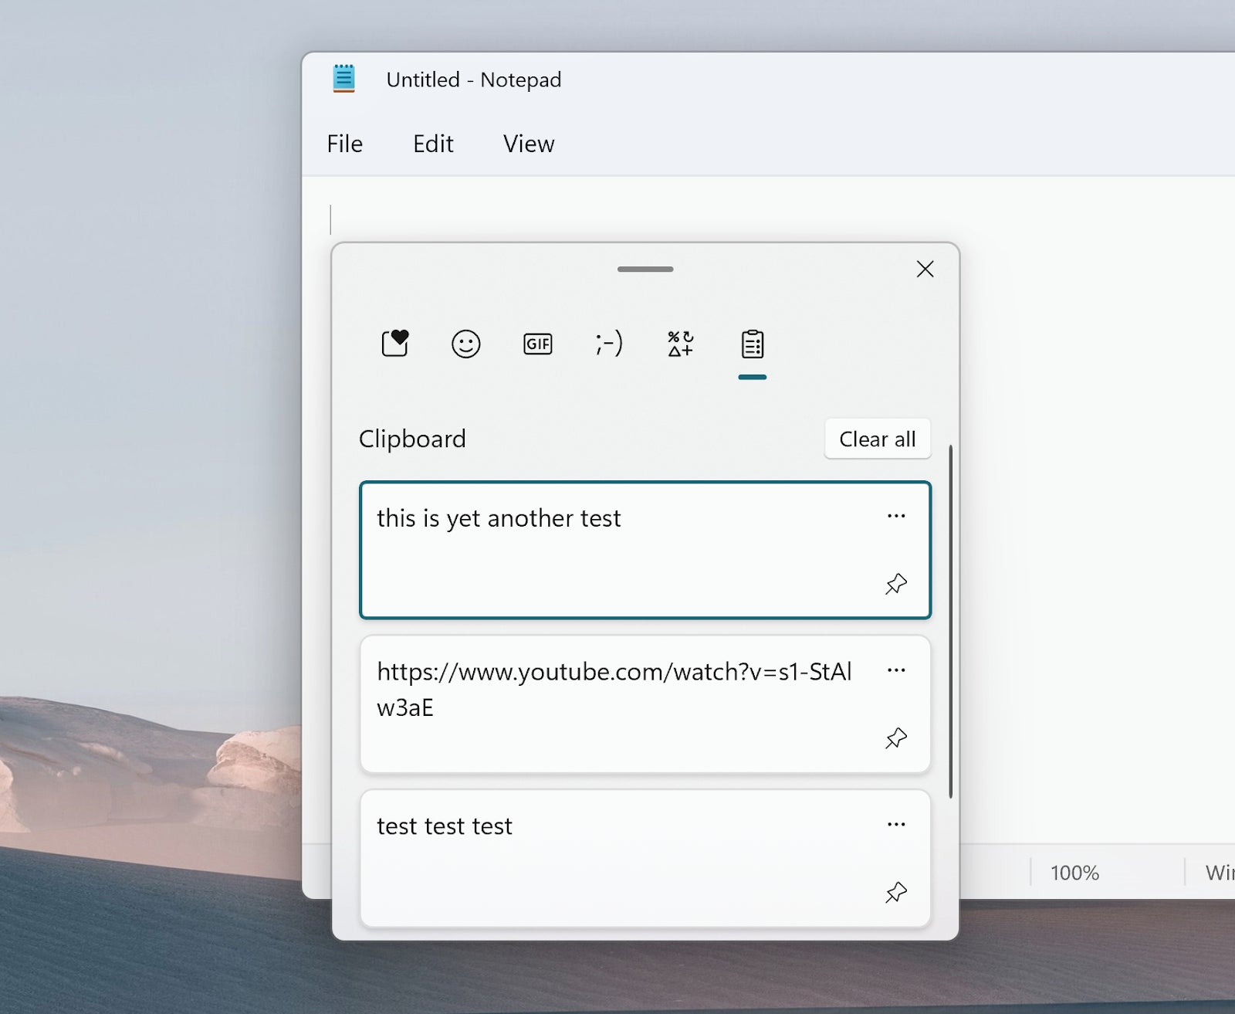
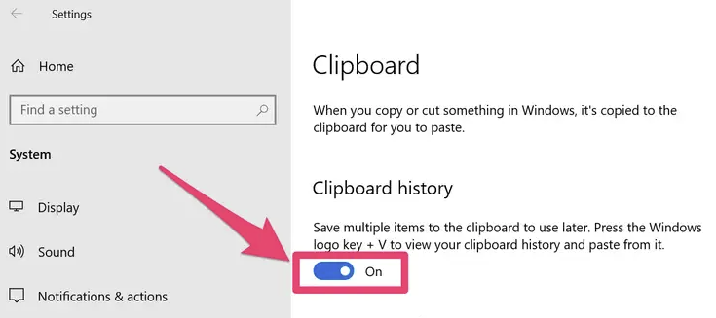
Clipboard history
  Mac - CopyLess 2
Notes:
Clipboard history
CopyLess 2 – clipboard manager for Mac

Slide 34
osint
  Google dorks
  “Zusy” AND “IOCs”
  "xcopy" AND (site:attack.mitre.org OR site:thedfirreport.com)

Slide 35
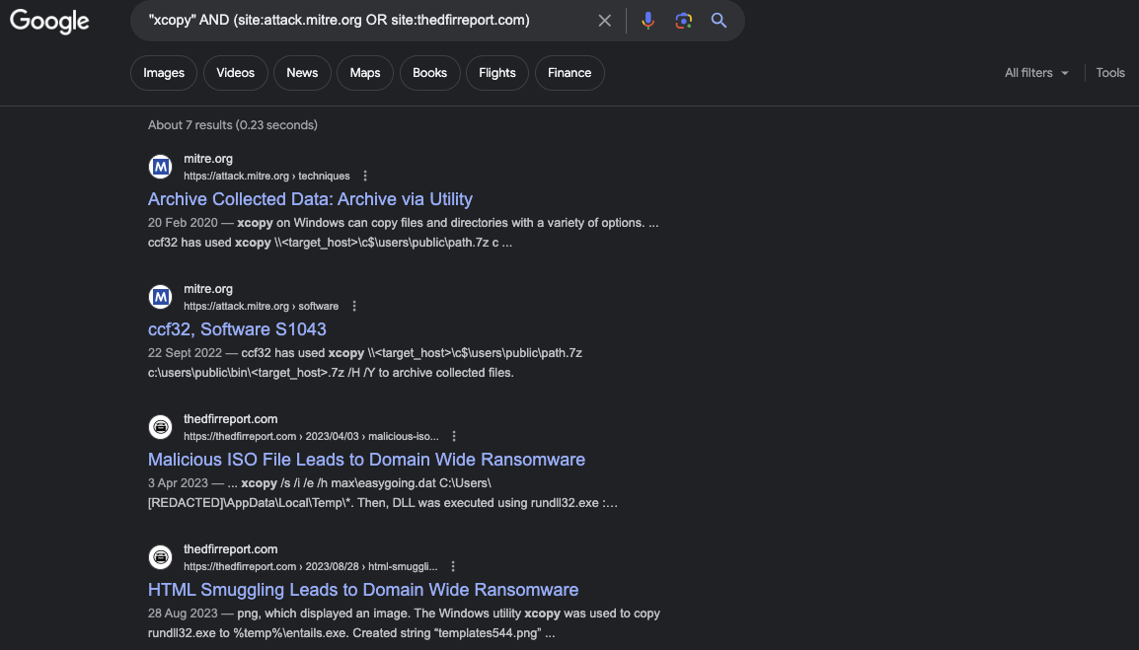

Slide 36
osint
  haveibeenpwned.com
  chat.openai.com

Slide 37
Log Transformation
  regex
  grep | sort | uniq > output
Notes:
awk, sed

Slide 38

Cyberchef
github.com/mattnotmax/cyberchef-recipes
huntress.com/blog/advanced-cyberchef-tips-asyncrat-loader
  Decode base64
  Defang IP / URL
  Diff
  Reverse
  Sort
  Unique
  Regex
  Find / Replace
  Remove whitespace / null bytes
  Extract IPs/emails/URLs/domains
  Syntax highlighter
  Code beautify
Notes:
Matthew Brennan – Huntress - malware analysis

Slide 39
Visual Studio CODE
  Multi cursor functionality for easy log manipulation
  Add Cursors to Line Ends
  Select All Occurrences

Slide 40
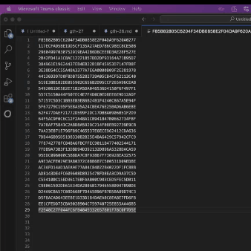

Slide 41
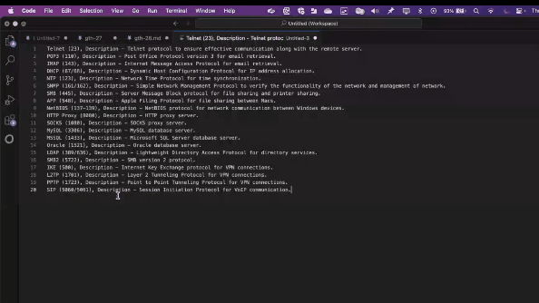

Slide 42
Education
  thedfirreport.com
  adsecurity.org/?page_id=4031
  Backdoors & Breaches

Slide 43
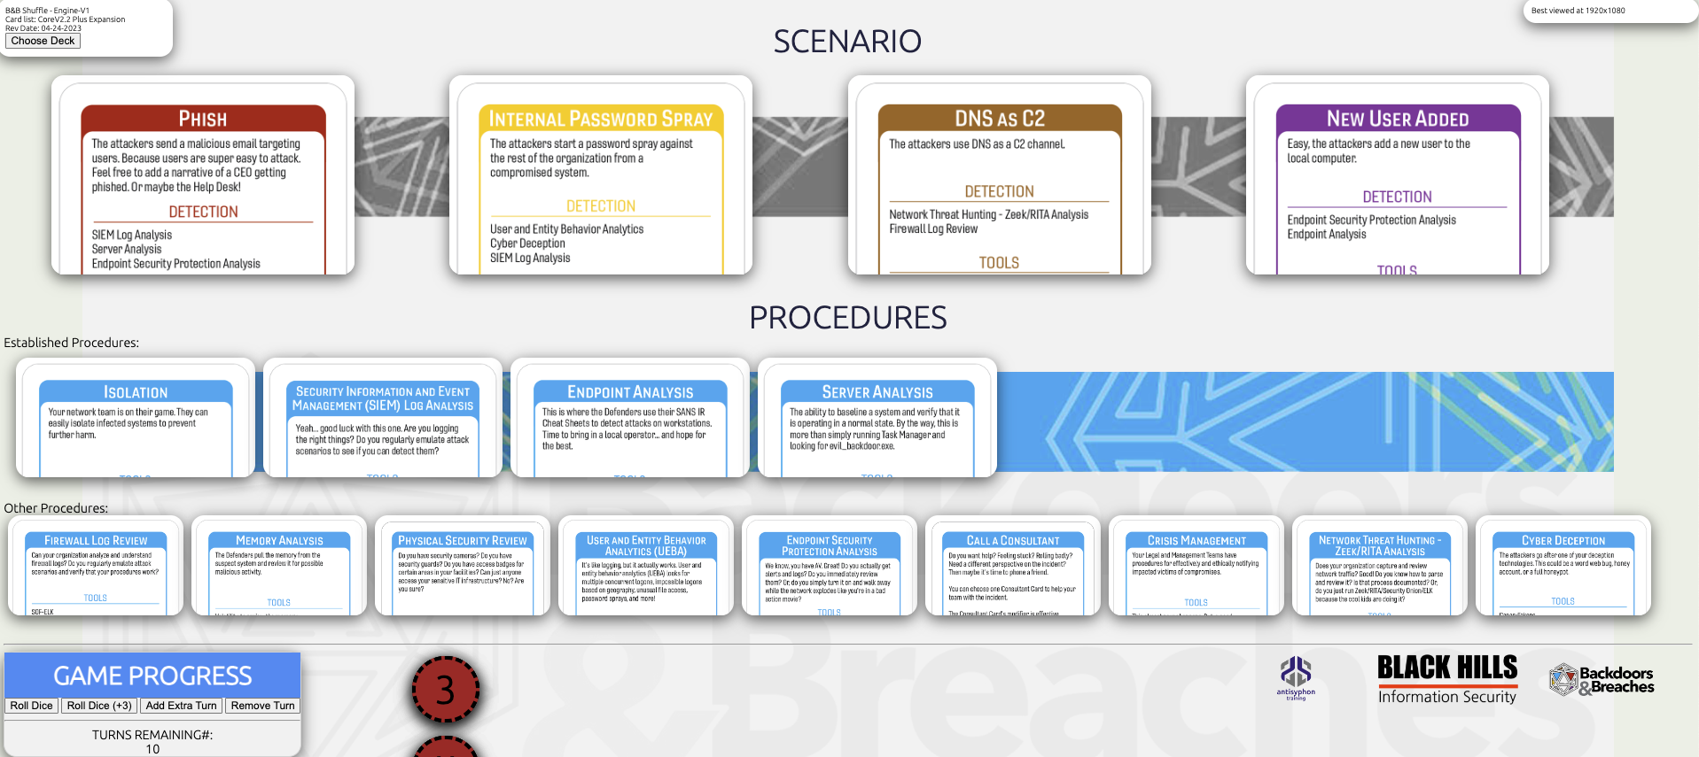
Backdoors & Breaches

Slide 44
Backdoors & Breaches
  BHIS | How to Use Backdoors & Breaches to do Tabletop Exercises and Learn Cybersecurity
  youtube.com/watch?v=pMY2HXUrKsg

Slide 45
Thank you!
  linkedin.com/in/samuel-kavaler

